Slide 1

Animal Carcass Review
Quantity Food Prep 2

Slide 2
To use this review tool, put the PowerPoints into presentation mode.
You will need to label carcasses for your final exam

Slide 3
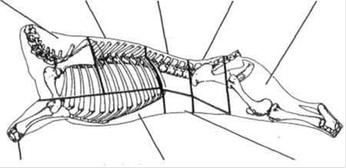
Veal
Hind Leg First Part
Hind Leg Second Part
4.
Shoulder
Hotel Rack
Loin
1.
2.
3.
5.
6.
Shank
7.
Breast
8.
Flank
Hind Leg First Part
Hind Leg Second Part
Loin
Shank
Shoulder
Flank
Hotel Rack
Breast

Slide 4
Lamb
Hotel Rack
Shoulder
Neck
Loin
Sirloin
Leg
1.
2.
3.
4.
5.
6.
Fore Shank
Breast
Flank
Hind Shank
10.
9.
8.
7.
Hotel Rack
Neck
Loin
Breast
Hind Shank
Fore Shank
Sirloin
Leg
Flank
Shoulder

Slide 5
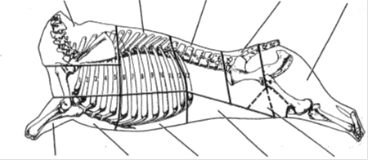
Beef
Rib
Shortloin
2.
Sirloin
4.
5.
Chuck
Round
1.
3.
Shank
Plate
Brisket
Flank
Sirloin Tip
10.
6.
9.
8.
7.
Short Loin
Sirloin Tip
Brisket
Plate
Rib
Chuck
Round
Sirloin
Shank
Flank

Slide 6
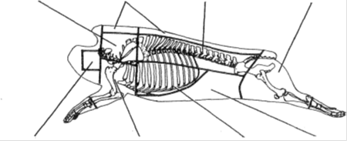
Pork
Boston Butt
2.
3.
Ham
1.
Fat Back
Loin
4.
Jowl
Picnic Shoulder
Bacon
Spare Ribs
8.
5.
6.
7.
Fat Back
Jowl
Ham
Spareribs
Boston Butt
Bacon
Loin
Picnic Shoulder

