Slide 1
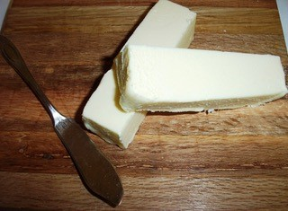
Butter and Fats in Baking
Chef Jennifer M. Denlinger, PhD, CCC, CHEP

Slide 2
Objectives
Learn by tasting the difference between different styles of butter
List various temperature that butter changes form
Define the different grades of butter
Identify the characteristics of a well baked biscuit

Slide 3
Fats in baking
To tenderize the product and soften the texture
Shortening shortens gluten strands
Add moisture and richness
Increase keeping qualities
Add flavor
Assist in leavening
creaming method, biscuit method, lamination

Slide 4
Butter
Butter can be defined as over whipped or churned cream into a solid fat.
Must contain a minimum of 80% milk fat and 2% milk solids.
The globules of fat in the cream are surrounded by a phospholipid membrane, which allows the membrane to float in water.
Agitation causes the membranes to break and clump together with water and other intact fat molecules.
Creates butter
The remaining liquid is the buttermilk. Originally fermented to use in baking
It takes 2 quarts of raw milk, separated into cream, to produce 1 pound of butter.

Slide 5
Butter Standards
Minimum butterfat amount in US and Canada is 80%
15% water, 5% milk solids and salt
European Butter ranges from 82–86% butterfat
"Light" butter contains 1/2 the calories, no more than 50% of the fat content, 46% less cholesterol, and 25% less salt
“Sweet Cream Butter” has not been salted
Salted butter has up 2.5% of salt

Slide 6
Butter Grades
Graded by the USDA into AA, A and B
Graded according to it's color, texture, taste, and fat levels. Sometimes an artificial coloring with the name of Annatto may be added.
AA is the highest quality butter. It is given to butters that have received a score 93-100.
A is just slightly less good, receiving a score of 92 or better
Grade B is given to scores between 90 or better and is used for baking
Although butter is regulated, good, fresh taste can not be guaranteed.
An ideal unsalted butter should have a clean taste, free of any off flavors, delicate smooth flavor, and a waxy smooth texture. There are many different things that could affect the quality of butter. Tempering of the cream could affect the color and texture. The diet of the cows also affects the quality of the cream used to make butter. In the summer, a yellowish butter is produced. In the winter, a whiter one.

Slide 7
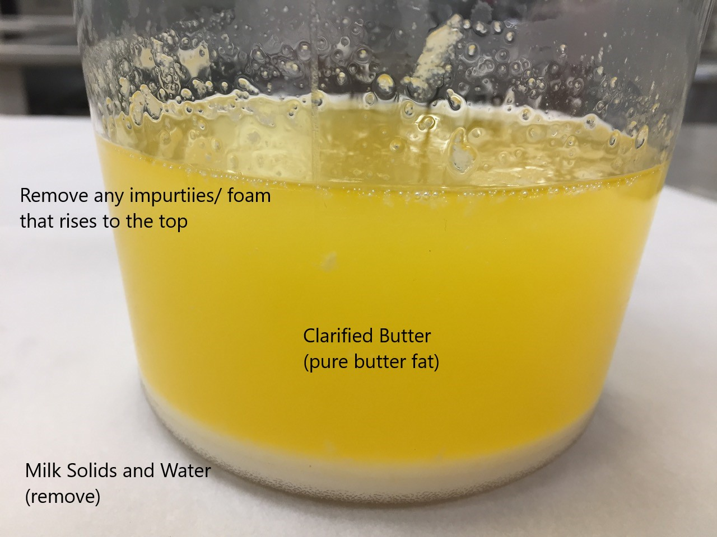
How to use butter
Melting point is around 95°F
Smoke Point- up to 350°F
Best working temperature is between 65° –70°F
Too cold at 50°F and too soft at 80°F
It should be stored under refrigeration with the temperature of 32°F to 35°F. It is best kept frozen.
To clarify butter, melt whole, unsalted butter. Remove the water and milk solids by skimming them off the top. Do not boil, or it may scorch. Clarifying butter makes it more stable, consistent, and richer.
Similar to clarified butter is ghee. It is clarified butter that has begun to brown. This raises the smoke point to 375°F. It originated in the region of India.

Slide 8
Butter history
In ancient times, butter was used in religious ceremonies, and as a medicine.
In Greek and Roman cultures, it was not cooked, but only used as a medicine.
Not introduced to Italy or France until the 15th century.
Butter is usually produced from cow milk, but can also be made from goats, donkeys, horses, buffaloes, or camels.

Slide 9
Other Types of Fat
Margarine- most made entirely from hydrogenated vegetable oils, with added skim milk or whey solids
Melting Point-94°-98°F
Smoke Point- 356°-370°F
Lard- Most is rendered (melted and clarified) from pork trimmings
100% fat
Melting Point- 95°-113°F
Smoke Point- 360°-375°F

Slide 10
More Fat
Suet- Fat from the area around the kidneys of cows and sheep
Melting Point- 113°-122°F
Smoke Point- 400°F
Vegetable Shortening- made from 100% vegetable oils, “hydrogenated” chemically treated to change some of the polyunsaturated fatty acids to saturated fatty acids, this makes the fat solid at room temp
Melting Point- 115°-119°F
Smoke Point- 325-375°F

Slide 11
And more fats
Oils
Liquid fats that come primarily from plants: seeds, nuts and vegetables
All contain the same amount of fat per tablespoon, however they vary greatly in percentage of saturated fat.
Coconut oil = 92% saturated fat
Canola = oil 7.6% saturated fat
The name "canola" was derived from "Canadian oil, low acid“ it is produced from the rapeseed

Slide 12
Storage
Butter is very susceptible to picking up odors and to oxidation, so it should be kept in an airtight container.
Butter should only be kept in the refrigerator for 2 or 3 weeks maximum.
It is good in the freezer if kept in an airtight container for several months.

Slide 13
Review
Does sweet cream butter have sugar in it?
What is different between American butter and European style butter?
What are the 3 grades of butter?
List some pros and cons of using different fats in baking.
Explain what buttermilk is?

