Slide 1

Proteins and Complimentary Proteins
Chef Jennifer M. Denlinger, PhD, CCC, CHEP

Slide 2
Objectives
Determine alternatives to a meat-based meal.
Try new protein alternatives
Calculate the differences of protein choices then compare their nutritional values.

Slide 3
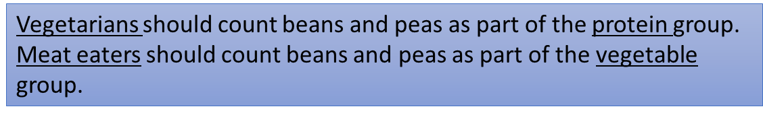
What is a protein value
1 ounce of meat, poultry, or fish =
¼ cup cooked dry beans
1 egg
1 tablespoon of peanut butter
½ ounce of nuts or seeds
¼ cup of tofu
2 tablespoons of hummus
½ soy or bean burger patty

Slide 4
Protein in Food
Incomplete proteins
Complete proteins
Animal sources
Plant sources such as quinoa, soybeans
Contains all amino acids
Plant sources= (dried beans, nuts, seeds, vegetables
A singular source does not contain all the amino acids

Slide 5
Complementary Proteins
When two or more incomplete proteins are eaten together over a course of a day so all amino acids are present.
Examples
1. Beans and tortillas
2. Peanut butter sandwich
3. Macaroni and cheese
4. Tofu with rice
5. Hummus with pita bread
6. Chickpeas and rice
As long as you eat a variety of plant foods, such as brown rice, corn, nuts, seeds, whole grains and wheat within each 24-hour period, your protein needs should easily be met.

Slide 6
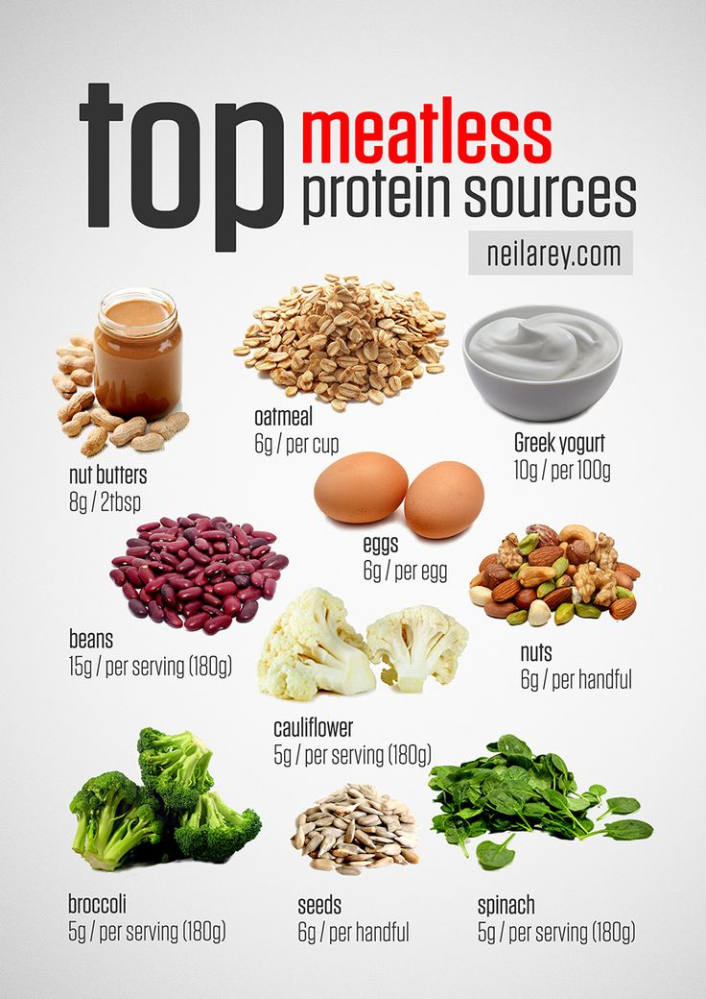

Slide 7
Protein and Health
Eating too much protein has no benefits and may result in:
  Excessive kcalories
  Excessive fat if you are eating too much high-fat animal foods
  Calcium loss
High intakes of animal proteins are associated with certain cancers, such as cancer of the colon

Slide 8

I can’t believe it’s not meat!!!!!!

Slide 9
How do you know which protein is the right choice?
Each group prepares one item.
  Prepare all the amount your instructor has provided to you.
  Make sure you prepare tasting size portions.
Use your textbook to fill in the you line-item data.
We will discuss what the best options based on the data, and taste values.

