Slide 1
The Building Blocks of Flavor
Developed by Michael Carmel CEC, CCE
The Flavor Pyramid is a simple way to deconstruct the complex art of building flavor
The six levels of the Pyramid
Ways to use the Flavor Pyramid

Slide 2
This seminar will cover the following:
How we taste and experience flavor
• The science of flavor
• The flavor components of various world cuisines
• The building blocks of complex flavor
• How to evaluate flavor
• How to create big, bold flavors

Slide 4
THE FLAVOR PYRAMID: LAYER BY LAYER
IT BEGINS WITH EMOTIONS
Childhood experiences
Memories, predisposed emotional perceptions

Slide 5
THE FLAVOR PYRAMID: LAYER BY LAYER
All Eyes on Flavor
Visual Appearance
Colors, contrast, size, height, plate coverage

Slide 6
THE FLAVOR PYRAMID: LAYER BY LAYER
The Nose Knows: Aromas
The Olfactory System
Bakery smells, brewing coffee
Aroma and taste work together- The buddy system

Slide 7
THE FLAVOR PYRAMID: LAYER BY LAYER
More Than A Feeling: Texture
Crunchy, Crispy, soft, firm,
mushy, smooth, creamy, etc.
Cooking al dente

Slide 8
THE FLAVOR PYRAMID: LAYER BY LAYER
Taste the Feel: Sensations
Sensations include burn, bite, astringency, pungency, cooling, numbing, fullness, tingle
Ex: hot chilies, lemon makes you pucker, cool milk extinguishes

Slide 9
THE FLAVOR PYRAMID: LAYER BY LAYER
The Big Matter of Taste
The basic tastes
1. Salty
2.Sweet
3. Sour
4. Bitter
5.Piquant
6. Umami

Slide 10
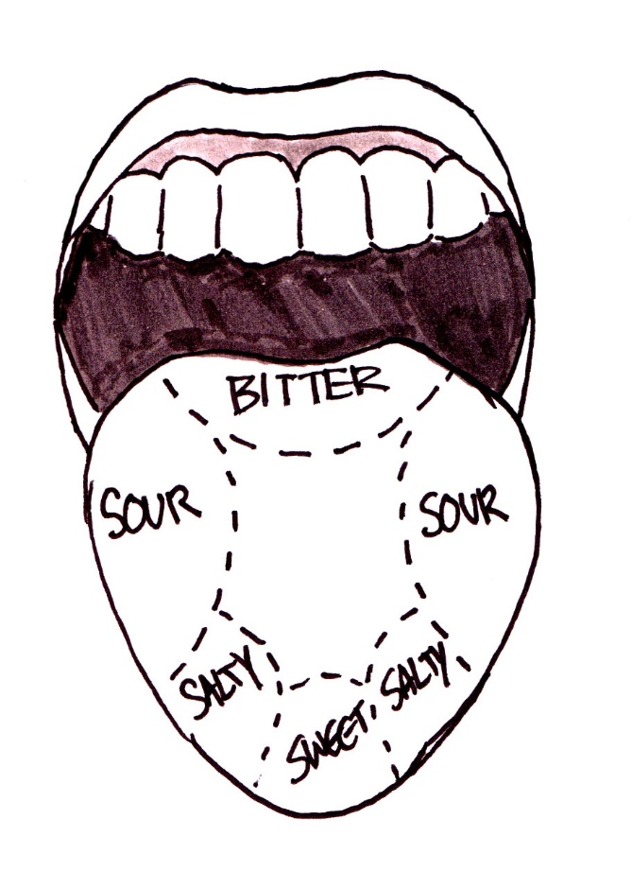

Slide 11
The Physiology of Taste
Brillat-Savarin
TASTING PHYSIOLOGY
“SMELL & TASTE FORM A SINGLE SENSE OF WHICH THE MOUTH IS THE LABORATORY AND THE NOSE IS THE CHIMNEY; OR TO SPEAK MORE EXACTLY, OF WHICH ONE SERVES FOR THE TASTING OF ACTUAL BODIES AND THE OTHER FOR THE SAVORING OF THEIR GASES.”

Slide 12
The Taste Buds
BUMPS ON THE TONGUE OR PAPILLAE KNOWN AS TASTE BUDS
THE AVARAGE ADULT HAS SEVERAL THOUSAND
CHILDREN HAVE LARGER AMOUNT OF TASTE BUDS
TASTE BUDS DECREASE IN HUMANS AFTER THE AGE OF 45
TASTE BUDS REGENERATE ABOUT EVERY 10 DAYS (IMPORTANT FACT TO KNOW, ESPECIALLY AFTER WE HAVE A CUP OF McDonalds COFFEE)

Slide 13
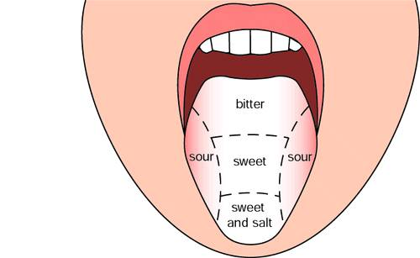
The Palate
5 BASIC AREAS OF TASTE
SWEET
SALTY
ACIDIC
BITTER
PIQUANT

Slide 14
Olfactory Cells
AVERAGE HUMAN HAS 5-10 MILLION
THESE ARE NERVE CELLS WITH A DIRECT LINE TO THE BRAIN IN THE FRONTAL LOBES.
THESE ARE THE ONLY NERVE CELLS IN THE BODY CAPABLE OF COMPLETE REGENERATION AND REPRODUCE EVERY MONTH OR TWO.
A DOG HAS 50X THE NUMBER OF CELLS.

Slide 15
OUR GREATEST SENSITIVITY TO TASTE COMES WHEN WE BREATHE OUT WITH OUR MOUTH CLOSED.
AIR FROM THE LUNGS PASSES ALONG THE BACK OF THE MOUTH AND BRINGS VAPORS WITH IT. (TRY TASTING FOOD WHEN YOU HAVE A COLD OR SINUS PROBLEMS)
AS OF 1984, 4300 FLAVOR COMPOUNDS HAVE BEEN IDENTIFIED. CURRENT ESTIMATE IS THAT 10,000 COMPOUNDS EXIST.
TYPICALLY, COOKED FOOD CONTAINS 300-800 COMPOUNDS.
WINE TASTING HAS A NARROW TASTE SPECTRUM AND A BROAD SMELL SPECTRUM

Slide 16
Building Flavor into Your Food
SALT- The key to Flavor & Life
PRIMARILY SODIUM CHLORIDE & SODIUM FLOURIDE
SODIUM BALANCE NEEDED FOR PHYSICAL ACTIVITY
HUMANS HAVE A RELATIVE SENSITIVITY TO SALT
SALT FOUND NATURALLY AND IN MANUFACTURED ITEMS
EXAMPLES(can do a vertical tasting)
IODIZED SALT KOSHER SALT SEASONING SALT
COARSE SALT / FINISHING SALT SEA SALT – SEVERAL TYPES

Slide 17
Building Flavor into Your Food
SWEET
SUCROSE – SIMPLE SUGAR, white, brown
GLUCOSE / DEXTROSE – COMPLEX
SUGARS, molasses, honey, maple
MALTOSE
FRUCTOSE - FRUIT
LACTOSE – MILK
Carameliztion- Mallard Principle

Slide 18
Building Flavor into Your Food
SWEET- Carameliztion- Mallard Principle
LOUIS-CAMILLE MAILLARD, FRENCH CHEMIST –1878-1936
HEATING OF AMINO ACIDS & SUGAR PRODUCE NEW FLAVOR COMPOUNDS
MORE INTENSE AND MORE COMPLEX FLAVORS
DEVELOPMENT OF BROWN COLOR THAT INCREASES WITH HEAT
PRINCIPLE RESULT OF COOKING & FERMENTATION
PRINCIPLE USED TO CREATE SYNTHETIC COMPOUNDS COMBING VARIOUS TYPES OF AMINO ACIDS W/ VARIOUS SUGARS

Slide 19
Building Flavor into Your Food
BITTER
EXAMPLE: BURNT CARAMEL
ONLY NON-PLEASANT FLAVOR OF BASIC FLAVOR SENSATIONS
AVOIDANCE TO THIS FLAVOR INERTLY DEVELOPED IN EARLY MAN DUE TO ITS ASSOCIATION WITH POISONOUS PLANTS
HUMAN PALATE IS 10,000 TIMES MORE SENSITIVE TO BITTER FLAVOR THAN ANY OTHER FLAVOR
QUININE & CAFFEINE ARE TWO BITTER ALKALOIDS WE ENJOY IN LOW CONCENTRATION

Slide 20
Building Flavor into Your Food
ACIDS
MAJOR SOURCES:
  CITRIC ACID-FRUITS AND VEGETABLES, raspberry, apple, rice wine,
  ACETIC ACID-VINEGAR, sherry, balsamic, champagne, red & white wine
  LACTIC ACID-MILK PRODUCTS
REASONS FOR PALATABILITY: VITAMIN “C” PREVENTION OF SCURVEY
OR ACCEPTABLE PH LEVEL
USED AS FLAVOR SUBSTITUTE IN REDUCING AMOUNT OF SALT

Slide 21
Building Flavor into Your Food
PIQUANT
EVOLUTION – PHYSIOLOGICAL EFFECT OF PERSPIRATION – COOLING THE BODY
IMPORTANT TO SEVERAL CULTURES THAT LIVE IN HOT CLIMATE
RELATIVE SENSITIVITY – CONDITIONING AND ENVIRONMENT
PEPPERS –SCOVILLE SCALE
OVERUSE – “BURN THE PALATE”
EXAMPLES:
CHILES PEPPERCORNS (green, black, white, pink)
HORSERADISH MUSTARD

Slide 22
Building Flavor into Your Food
UMAMI
JAPANESE TERM REFERRING TO SATISFYING MEAT TASTE FOUND GENERALLY IN PROTEIN FOODS.
FOUND IN:
MEAT HARD GRATING CHEESE (Parmesean)
SOY PRODUCTS SMOKY PRODUCTS
SEA WEED CARAMELIZATION
MUSHROOMS

Slide 23
Building Flavor into Your Food
MARINADES DRY RUBS
NFUSED OILS SALSA
VINAIGRETTES CITRUS REDUCTION
INFUSIONS SMOKING

Slide 25
Shared Sense of Community
IDENTIFIERS OF CIVILIZATIONS
EXAMPLES:
MEXICO & LATIN AMERICA – CHILES
CHINA & THE FAR EAST -
FERMENTED SOY BEANS
INDIA - TURMERIC & CARDAMON
THE MEDITERRANEAN - OREGANO & GARLIC

Slide 26
Flavor Combinations
HEAT AFFECTS PALATABILITY
FATS AFFECT PALATABILITY
SWEET & SOUR – ASIAN CONCEPT
MAXIMIZE FLAVOR AT RANGE BETWEEN 72-105 DEGREES.
SWEET & SOUR MAXIMIZED AT THE HIGHER TEMPERATURE
RANGE
BALANCE OF FLAVORS EXTREMELY IMPORTANT IN COMBINATION FLAVORS

Slide 27
SEVERAL TYPES OF COMBINATIONS
  SWEET & SOUR – ORANGE SAUCE
  HOT & SOUR – CHINESE SOUP
  ACID/FAT – FATTY MEAT & LEMON
  ACID/FAT/PIQUANT – CHIPOTLE BBQ PORK
  5. FAT/ACID/PIQUANT/SWEET – BBQ
PORK W/SWEET BBQ SAUCE

Slide 28
Lets Do Some Tasting
#1 salt – kosher and fleur de sel
#2 sugar- caramel
#3 caramelized onions-plain and with vinegar
#4 salad dressing / wing sauce
#5 sautéed mushrooms in soy w/ seaweed
#6 dry rub Chicken with chipotle BBQ spice
#7 Garam Masala
#8 bitter chocolate vs semi-sweet chocolate w/ Pretzels

