Slide 1
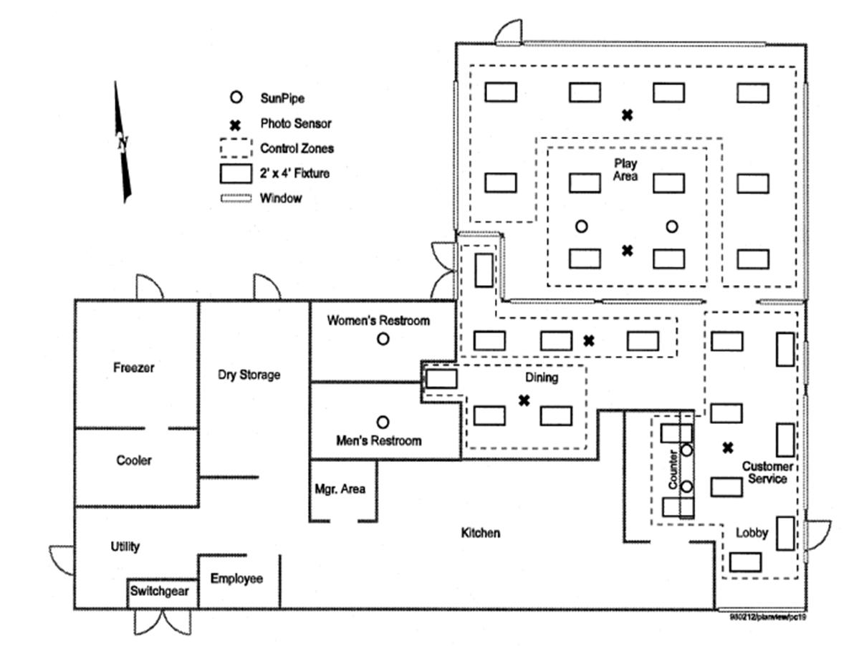
How Efficient is Your Kitchen?

Slide 2
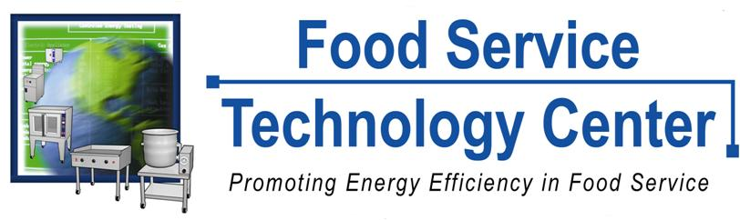
Developed by:
Notes:
2

Slide 3
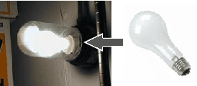
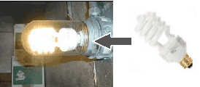
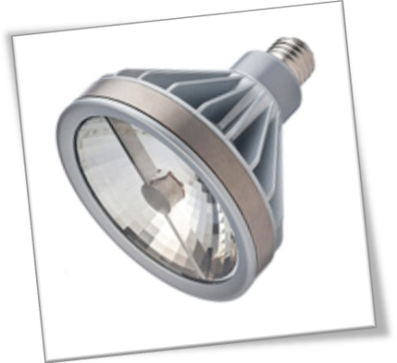
Lighting
Incandescent Light Bulb
Compact Fluorescent
LED Lamp

Slide 4
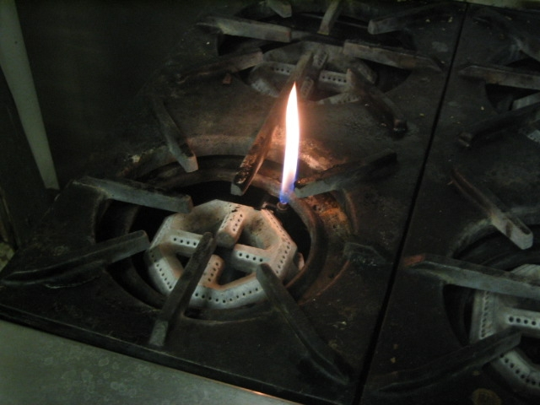
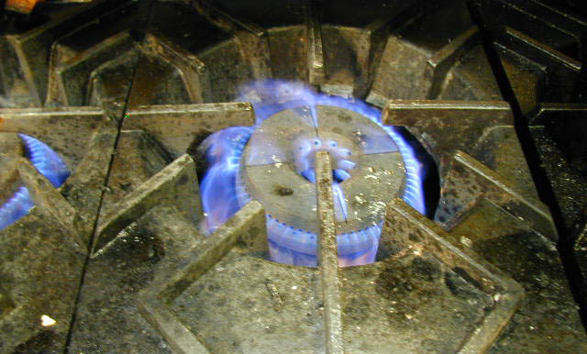
Range Tops
Pilot lights and burners that are poorly adjusted will waste energy.

Slide 5
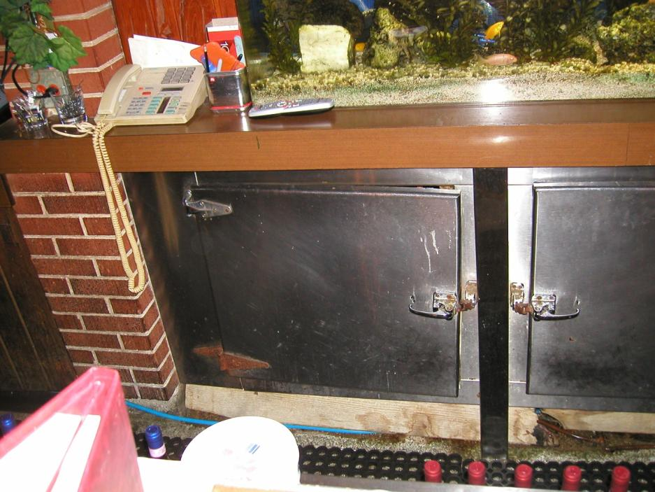
Kitchen Equipment
Align doors

Slide 6
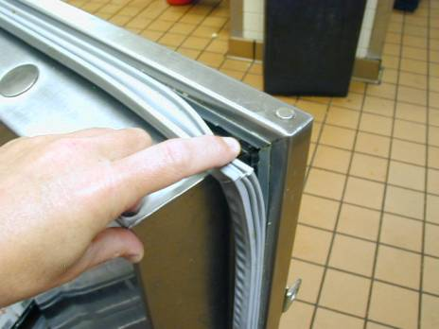
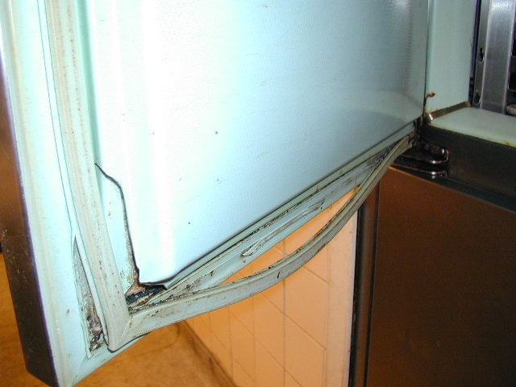
Kitchen Equipment
Door Gaskets

Slide 7
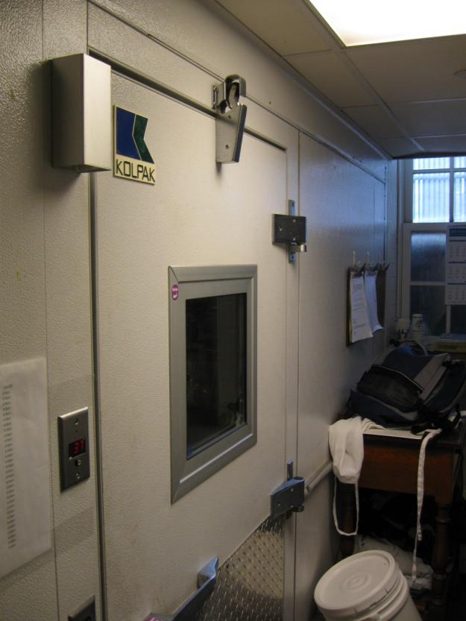
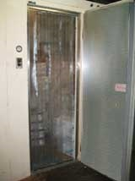
Cooler Doors
automatic door closer
Strip Curtain

Slide 8
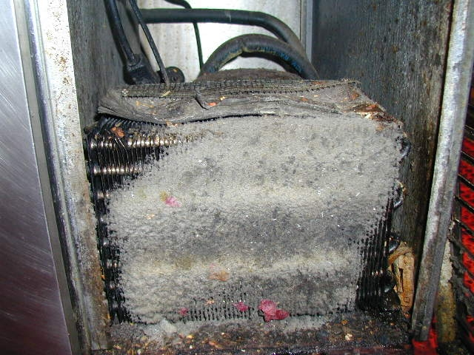
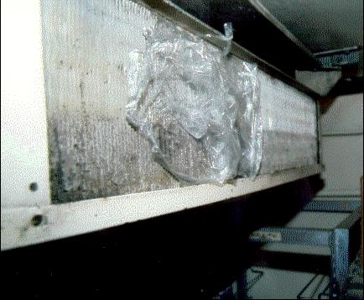
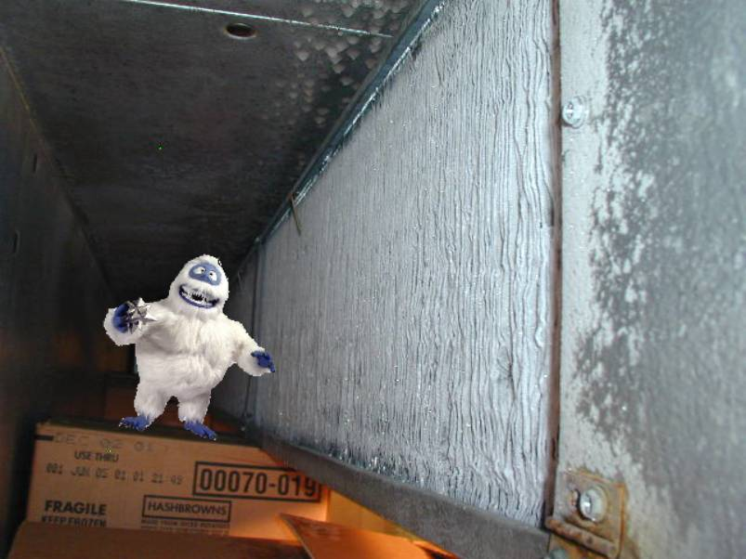
Cooler Evaporator Coils
Dirty
Trashy
Frozen

Slide 9
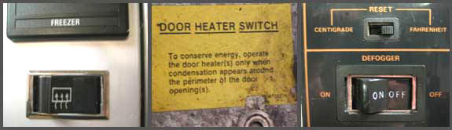
Cooler Door Heaters
Operate door heaters only when condensation appears around the perimeter of the door.

Slide 10
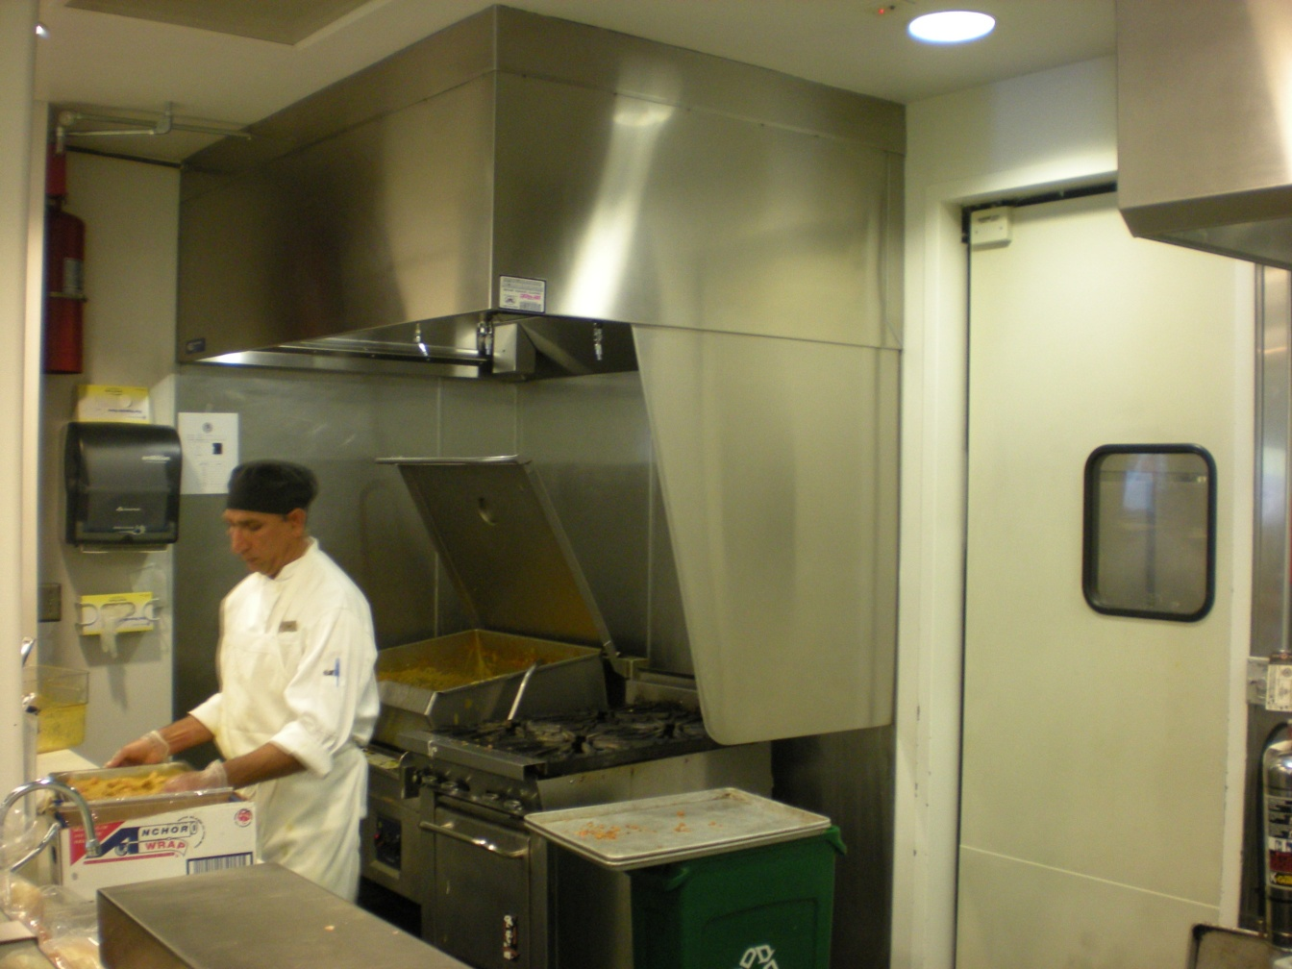
Exhaust Hoods
Are there side panels to capture exhaust?

Slide 11
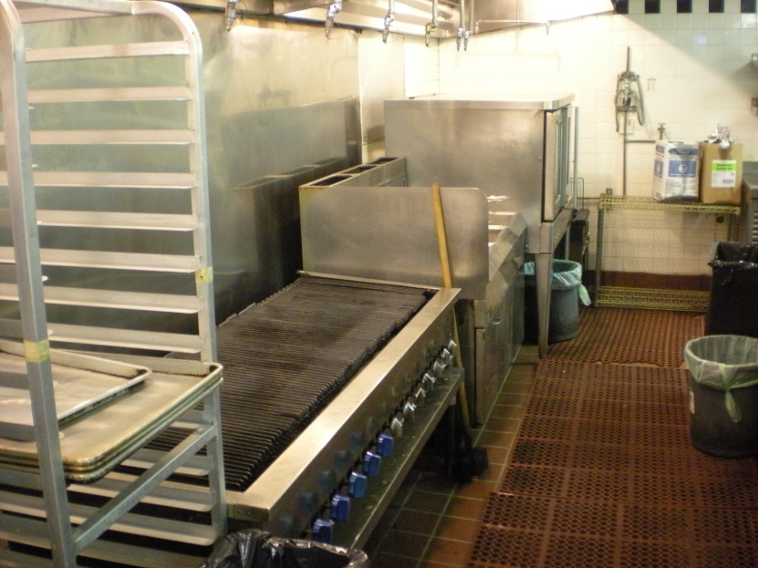
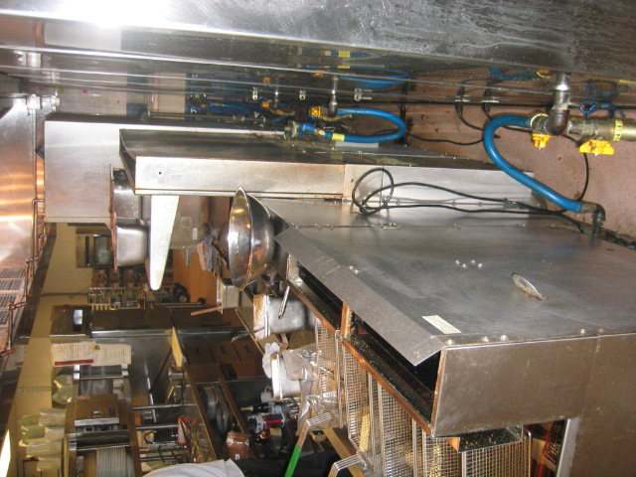
Exhaust Hoods
Is equipment placed close to wall to wall to maximize hood efficiency?

Slide 12
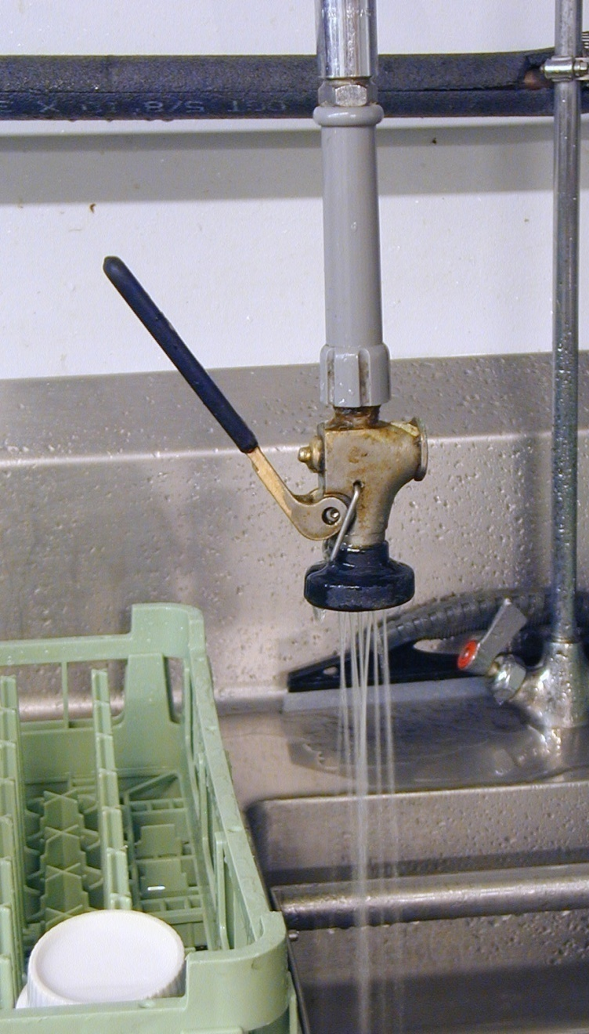
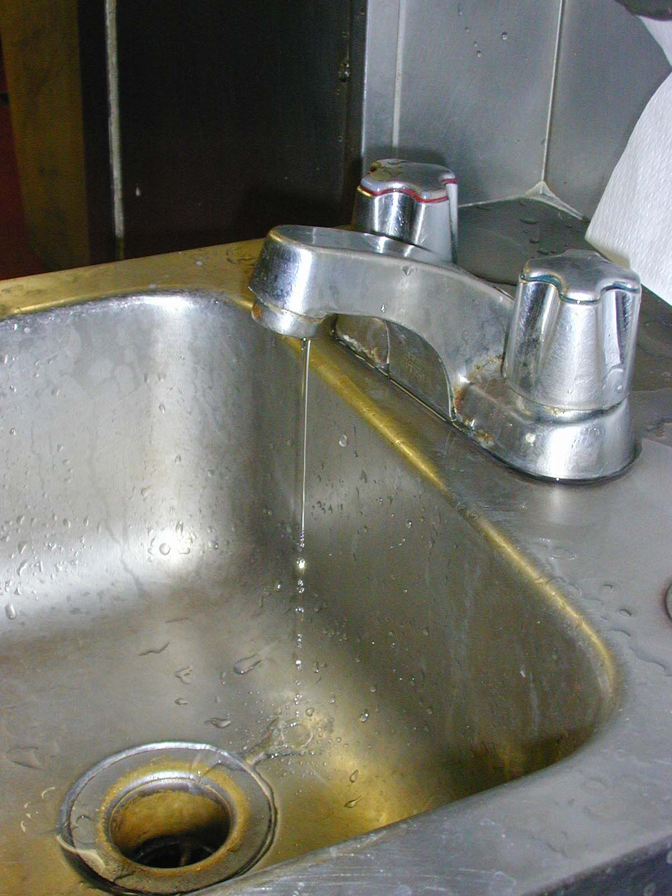
Water Faucet Leaks

Slide 13
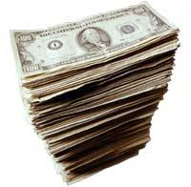
Water Leaks – Is it hot water? If so, it costs you three times!
Heating
Energy
Water
Sewer

Slide 14
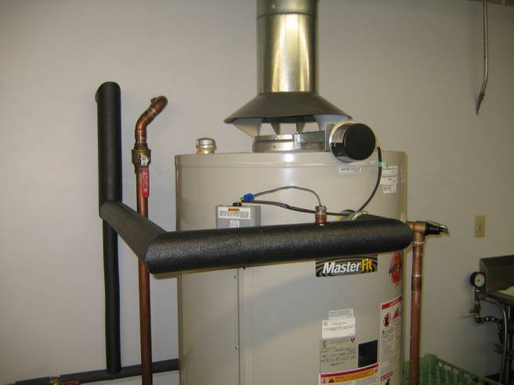
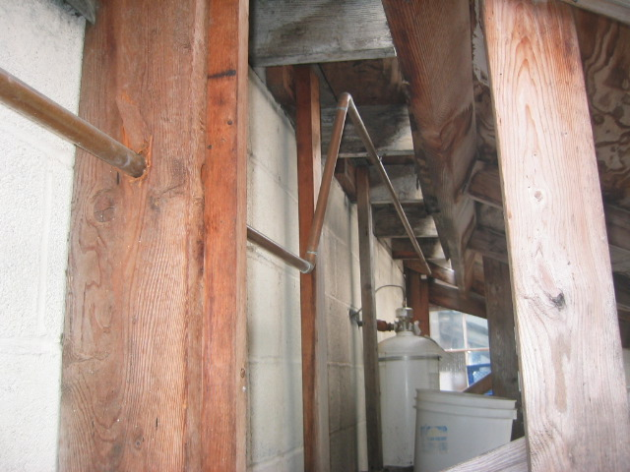
Water Line Insulation
Insulated
Uninsulated

Slide 15
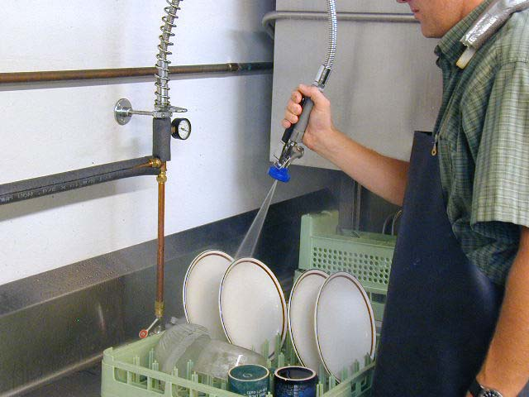
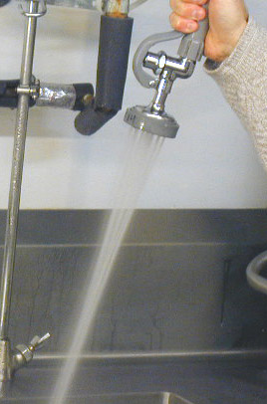
Pre-Rinse Spray Valves
Traditional Spray Valve
Use low-flow Pre-Rinse Spray Valves

Slide 16
Pre-Rinse Spray Valves
Hours of Spray Valve Usage | Water Savings gallons/day | Waste Water Savings gallons/day | Gas Savings therms/day | Annual Dollar Savings
1 hour/day | 60 gallons | 60 gallons | 0.5 therms | $300 - $350
2 hours/day | 120 gallons | 120 gallons | 1.0 therms | $600 - $700
3 hours/day | 180 gallons | 180 gallons | 1.5 therms | $900 - $1050
Table shows results based reducing water flow by one gallon per minute, water cost of $2 per unit (748 gal), sewer cost of $3 per unit (748 gal.) and gas cost of $1 per therm.

Slide 17
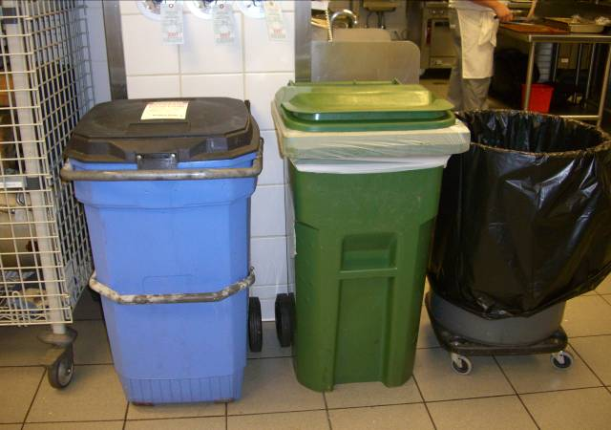
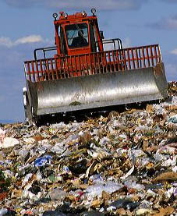

Recycling & Composting

Slide 18
What about work habits?
Cooler doors open or propped open?
Pay careful attention to kitchen "plug loads". For instance, turn off holding cabinets, coffee machines, conveyor toasters, steam tables, plate and food warmers, and heat lamps when not needed.
When are hoods on?
What about lights?

Slide 19

Thanks!

