Slide 1

Learning Styles and You
Chef Jennifer M. Denlinger, PhD, CCC, CHEP

Slide 2
Objectives
Introduce learning styles and understand how learning within that modality can be beneficial to you.
Take a modified Learning Styles “quiz” to determine which learning style(s) you prefer
Talk about some of the techniques you can use to be successful with your study habits

Slide 3
Learning styles
A learning style is defined as “the characteristics, strengths and preferences in the way people receive and process information”
It is an individual’s preferred method of gaining knowledge.
Notes:
Gokalp, M. (2013). The effect of students' learning styles to their academic success.
Creative Education, 4(10), 627-632. Retrieved from
http://search.proquest.com/docview/1473862751?accountid=28844

Slide 4
The Common Learning Styles
V visual
A auditory or aural
R read/ write
K kinesthetic

Slide 5
What are you?
People commonly have a main preferred learning style
  Some people have a very strong preference;
  other people have a more even mixture of two, three or less commonly, four styles.

Slide 6
How knowing your learning style can benefit you
When you know your preferred learning style(s) you understand the type of learning that best suits you.
This enables you to choose the types of learning that work best for you.
There is no right or wrong learning style.
  The point is that there are types of learning that are right for your own preferred learning style.

Slide 7
Let’s see what your learning style(s) is!
Complete the VARK self assessment (pg. 1-2), 7 questions

Slide 8
Results!
Now let's total up how many of each response you got.
Use the chart on pg. 3 to record your responses (first row)
 | 1. | 2. | 3. | 4. | 5. | 6. | 7.
Quiz Answer
VARK

Slide 9
What did you choose for each?
Look at the “answer key” under the chart and write in the corresponding letter. (second row)
i.e.- if you have A for question 1, write R
 | 1. | 2. | 3. | 4. | 5. | 6. | 7.
Quiz Answer | a
VARK | R

Slide 10
Total up your responses
Total how many each of V, A, R, K that you have and record below? (bottom of pg. 3)
V
A
R
K
What is your strength?
Do you have a secondary strength?

Slide 11
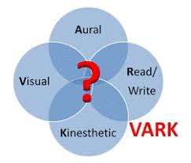
What are you????

Slide 12
Visual
V
Someone with a Visual learning style has a preference for seen or observed things, including pictures, diagrams, demonstrations, displays, handouts, films, flip-chart, etc.
  “graphic”
  These people will use phrases such as ‘show me’, ‘let’s have a look at that’ and will be best able to perform a new task after reading the instructions or watching someone else do it first.
  These are the people who will work from lists and written directions and instructions.
Notes:
https://www.umassd.edu/dss/resources/faculty--staff/how-to-teach-and-accommodate/how-to-accommodate-different-learning-styles/
https://www.teachhub.com/vark-model-teaching-strategies

Slide 13
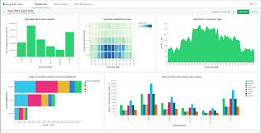
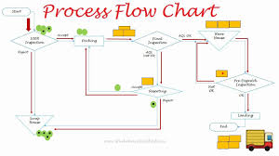
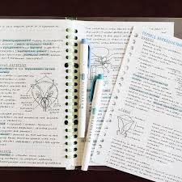
Visual Students’ Prefer…..
Maps
Charts
Graphs
Symbols
Diagrams
Overviews
Flow Charts
Handwritten notes instead of printed/ typed
Cartoons
Notes:
Denlinger, J.M. (2018) The effects of brain dominance on culinary and pastry students’ learning styles 5
Fleming N. (2012). Teaching and learning styles: VARK strategies. Retrieved from http://varklearn.com/wp-
content/uploads/2014/08/VARK-Teaching-and-Learning-Styles.pdf

Slide 14
Visual Students’ study tips.....
Convert your “notes” into a learnable package by reducing each three pages down to one page.
Replace some key words with symbols or drawings. →@ *
Look at your pages and search for patterns.
Practice turning your visuals back into words.
Draw things to show your ideas.
Turn complex processes and lists into flowcharts
Create your own symbols to simplify things
Make each page of your notes look different
Spend time on the design of your presentations and less on the content
Underlining
Highlight words and important ideas
Use Different Colors and separate sections by colors
Handwrite your notes/ lectures
Notes:
https://vark-learn.com/strategies/

Slide 15
Auditory/ Aural
A
Someone with an Auditory learning style has a preference for the transfer of information through listening: to the spoken word, of self or others, of sounds and noises.
  “heard or spoken”
  These people will use phrases such as ‘tell me’, ‘let’s talk it over’ and will be best able to perform a new task after listening to instructions from an expert.
  These are the people who are happy being given spoken instructions over the telephone and can remember all the words to songs that they hear!
Notes:
https://www.umassd.edu/dss/resources/faculty--staff/how-to-teach-and-accommodate/how-to-accommodate-different-learning-styles/
https://www.teachhub.com/vark-model-teaching-strategies

Slide 16

Aural Students’ Prefer…..
To explain
Discussions
Texting Summaries
Recording lectures
Training and Teaching Sessions
Leaving lots of spaces in their notes
Sharing ideas with others
Describing the slides/ PP, pictures and other Visuals
Remembering the interesting examples
Quiet atmospheres
Meetings
Notes:
Denlinger, J.M. (2018) The effects of brain dominance on culinary and pastry students’ learning styles 5
Fleming N. (2012). Teaching and learning styles: VARK strategies. Retrieved from http://varklearn.com/wp-
content/uploads/2014/08/VARK-Teaching-and-Learning-Styles.pdf

Slide 17

Aural Students’ study tips.....
Convert your notes into a learnable package by reducing them into memorable ways for you to recall (three pages down to one page)
Ask to record lectures/ demos, etc. Take your notes later from the recordings
  You will need to expand your notes by talking with others and collecting notes from other sources. Leave spaces in your notes for later recall and ‘filling’
Read your summarized notes aloud
Explain your notes to another person with an Aural preference; ask others to “hear” your understanding of a topic
Record your summarized notes and listen to them/ study
Attend classes, discussions and tutorials to get the information firsthand
Discuss topics with your teachers and other students. Explain new ideas to other people.
Remember interesting spoken examples, stories, jokes…
Recall information through self-talk
Communicate and express yourself through Email, Texting, Blogs Twitter
Notes:
https://vark-learn.com/strategies/

Slide 18
Read/ Write
R
Someone with a Read/Writing learning style has a preference for information to be displayed in words – text-based information, reports, manuals, essays and assignments.
  “displays of words”
  These people will use words such as: let me read the instructions, let me write you a report, I will do my presentation on a PowerPoint.
  These are the people who will like to read about a subject, follow written instructions and write their responses.
Notes:
https://www.umassd.edu/dss/resources/faculty--staff/how-to-teach-and-accommodate/how-to-accommodate-different-learning-styles/
https://www.teachhub.com/vark-model-teaching-strategies

Slide 19

Read/Write Students’ Prefer…..
Lists and put them in categories
Notes
Essays
Reports
Contracts
Textbooks (physical, not digital)
Glossaries/Definitions/ Dictionaries
Quotations
use titles and headings that clearly explain what follows
to arrange words into hierarchies and points; order and structure in anything presented
PowerPoints
Handouts
Wordy Mind Maps
Laboratory Manuals
Websites and Webpages
Taking Notes (verbatim)
Journaling
Multiple Choice Tests
Notes:
Denlinger, J.M. (2018) The effects of brain dominance on culinary and pastry students’ learning styles 5
Fleming N. (2012). Teaching and learning styles: VARK strategies. Retrieved from http://varklearn.com/wp-
content/uploads/2014/08/VARK-Teaching-and-Learning-Styles.pdf

Slide 20


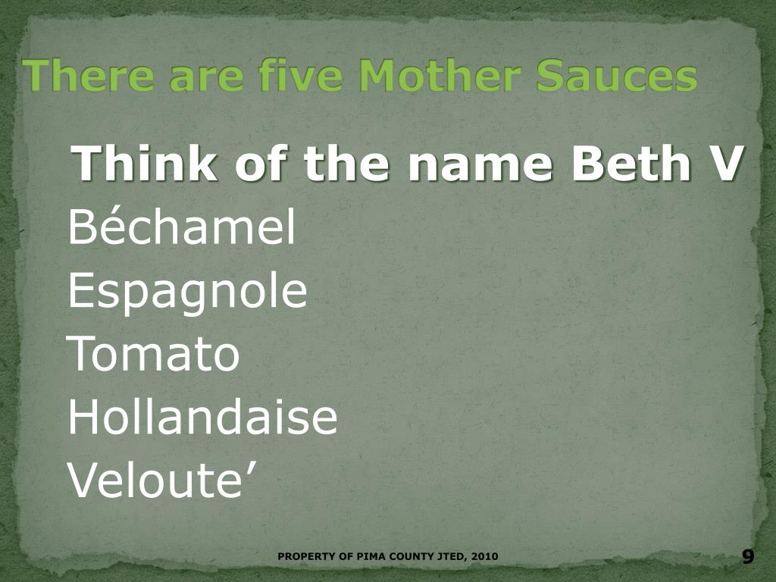
Read/Write Students’ study tips.....
Convert your “notes” into a learnable package by reducing them from three pages down to one page.
Write out the words again and again.
Read your notes (silently) again and again.
Do any “extra” suggested reading
Organize any diagrams, graphs … into statements, e.g. “This graph shows that the trend is…”
Make Mnemonics to help you remember points
Use a digital device to arrange your ideas Imagine your lists arranged in multiple choice questions and distinguish each from each.
Write out your words for others to read, use handouts, noticeboards, and post-its.
Read carefully what others have written.
Write lists of tasks and carefully record important print information.
List out what your need to do/ study.
Notes:
https://vark-learn.com/strategies/

Slide 21
Kinesthetic
K
Someone with a Kinesthetic learning style has a preference for physical experience - touching, feeling, holding, doing, practical hands-on experiences.
  “perceptual preference related to the use of experience and practice (simulated or real).”
  These people will use phrases such as ‘let me try’, ‘how do you feel?’ and will be best able to perform a new task by going ahead and trying it out, learning as they go.
  These are the people who like to experiment, hands-on, and never look at the instructions first!
Notes:
https://www.umassd.edu/dss/resources/faculty--staff/how-to-teach-and-accommodate/how-to-accommodate-different-learning-styles/
https://www.teachhub.com/vark-model-teaching-strategies

Slide 22
Kinesthetic Students’ Prefer…..
Field Trips
Case Studies
Trial and Error
Applied Opportunities
Examples of Principles
Doing things to understand them
Exhibits, Samples, Photographs
Laboratories/ Practical Sessions
Real-life Examples hands-on approaches
Recipes
practical problems/ problem solving techniques/ Solutions to problems
Using all your senses pictures collections of similar subjects to compare
applications before theories
talking about real things in their life.
doing things with others; action; making things happen/ being part of a team
finishing tasks
outcomes that can be measured
use all your senses use hands-on approaches
watch videos, esp. those that show real things
attend laboratory and practical sessions
use surveys, field trips and interviews
take notice of real-life examples and personal stories
look for examples of principles
Notes:
Denlinger, J.M. (2018) The effects of brain dominance on culinary and pastry students’ learning styles 5
Fleming N. (2012). Teaching and learning styles: VARK strategies. Retrieved from http://varklearn.com/wp-
content/uploads/2014/08/VARK-Teaching-and-Learning-Styles.pdf

Slide 23
Kinesthetic Students’ study tips.....
Go back and fill in missing notes after you have completed tasks
Search for the reality and the applications of any ideas
Role-play scenarios/ talk through options
Put plenty of examples into your notes and your answers
Builds notes backwards filling in information once the outcome has been achieved
Practice makes perfect
Hands on approaches
Remember the “real” things that happened. Search for the reality and the applications of ideas.
Find pictures and photographs that illustrate an abstract idea, theory or principle.
Use previous exam, assessment and test papers to study from. You want to experience the exam so that you can understand it; recall previous examinations, especially those where you did well.
look for opportunities to apply what you have learned
Notes:
https://vark-learn.com/strategies/

Slide 24
Concluding thoughts
Trying using some of the studying techniques based on your Learning Style preference(s)
Realize and understand that some ways of learning may not be easy to do and try to convert those methods into techniques you can use.
The more you can do in your preferred Learning Style(s) the more efficiently you can learn it!
Notes:
Reid, J. (Ed.). (1995). Learning styles in the ESL/EFL classroom. Boston, MA: Heinle
and Heinle Publishers.

