Slide 1

Sugars and Sweeteners
Chef Jennifer M. Denlinger, PhD, CCC, CHEP

Slide 2
Objectives
Define what a sugar is.
Identify types of sugar.
Look at the Chemical breakdown of sugars
Learn about the properties of different sugars
Learn what sugar on a nutritional label looks like
Taste the difference between difference sugars and sugar substitutes

Slide 3
Sugar
Sugar: any sweet tasting carbohydrate
Naturally formed in the leaves of numerous plants (as a result of photosynthesis)
Mainly concentrated in the stems, roots and fruits
Sugars have the suffix of “ose”

Slide 4
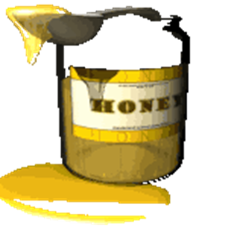

Simple Carbohydrates
Natural sugars:
Found in fruit, milk, honey
Added sugars:
Sugars added to a food for sweetening or other purposes, do not include natural sugars
Granulated sugar, corn syrup, high fructose corn syrup, molasses, powdered sugar, honey, invert sugar, Demerara, Turbinado sugar
Found in soft drinks, jams and jellies, baked goods, and other foods
Notes:
Added sugar is added to food for sweetening. Does not include naturally occurring sugars in foods such as fruit and milk.
HFCS: has been treated with an enzyme that converts part of the glucose it contains to fructose.
Corn syrup: thick sweet syrup made from cornstarch. Mostly glucose with some maltose
Molasses: Thick syrup left over after making sugar from sugar cane
Powdered sugar: granulated sugar that has been crushed into a fine powder and combined with a small amount of cornstarch to prevent clumping
Honey: made by bees from nectar in flowers during pollination. Rich in antioxidants, minerals and amino acids.
Invert sugar: white sugar has been heated with water and acid breaking down some of the sucrose into glucose and fructose. Only in liquid form
Demerara: light brown sugar with large crystals named after a region in South America (origin) Not as processed as white sugar. Popular for tea in Canada, England and Australia
Turbinado: Made from sugar cane not as processed as white sugar, retains some of the molasses that gives it light brown color.

Slide 5
Forms of Sugars
Cellulose- Sugars found in legumes and vegetables.
Dextrose Sugar- Crystallized and powdered corn sugar. Obtained by hydrolyzing cornstarch with sugar. Less sweet than sucrose and dissolves at a lower temperature.
Fructose- A sugar obtained from fruit and from most vegetables. Double the sweetening power of sucrose. Known to enhance fruit flavor. It is the sweetest of all sugars. A monosaccharide.
Glucose- Most naturally occurring sugar. Found in many plants, especially corn. Effective in preventing crystallization and increasing pliability of molten sugars. 1/2 as sweet as granulated sugar. Browns at a lower temperature. Contains 15-19.7% water. Enters bloodstream to provide energy. Stored in liver as glycogen.

Slide 6
Sugars Continued
Hemicellulose- Main fiber found in cereals. Speeds up digestion.
Lactose- A disaccharide sugar composed of glucose and galactose. Found only in milk and milk products. Contains lactic acid. Will not crystallize.
Maltose- A disaccharide sugar composed of two glucose molecules. NOT naturally occurring. Created by hydrologing a starch with a diastasic enzyme found in malt. Used in beer, bread, and baby food, etc.
Sucrose- A disaccharide sugar composed of glucose and fructose. Present in all plants that use photosynthesis. Also called saccharose.

Slide 7
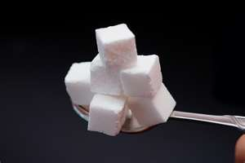
Added Sugars and Health Concerns
Dental caries (sugar & starch)
Obesity
Diabetes
Heart Disease
Hypoglycemia
Hyperactivity in Children
Notes:
Sugar contributes to the development of cavities. Bacteria on teeth ferment after eating something sweet that produces acid, that eats away at your teeth.
Sugar may play a factor in the high rate of obesity
Body does not metabolize carbs properly
Moderate intake of sugar does not increase the risk of heart disease but diets high in fructose and sucrose seem to increase blood triglyceride levels and LDL cholesterol.

Slide 8
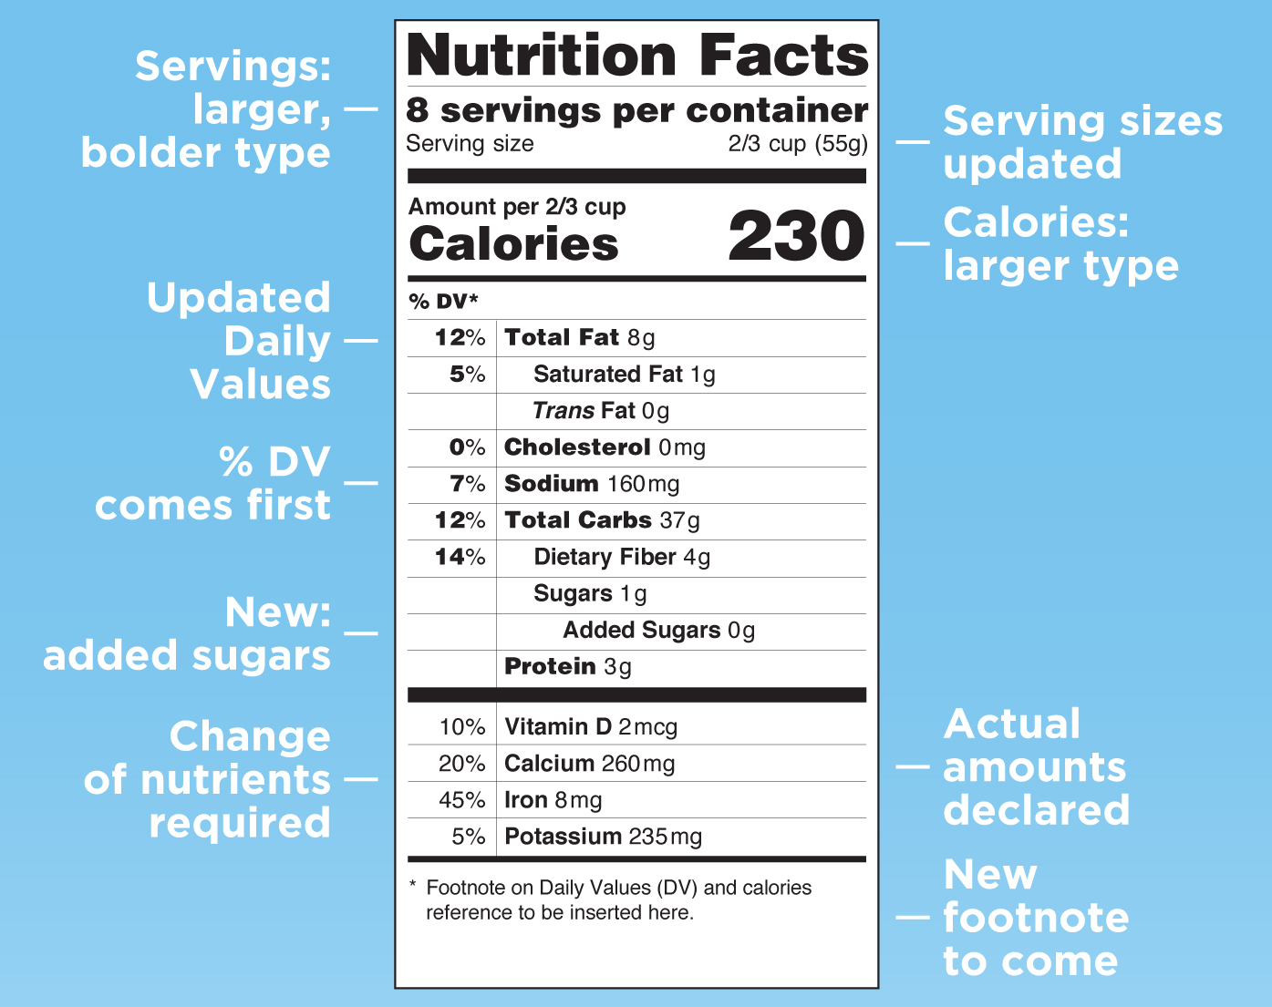
Sugars on the new Nutrition Facts Label
The number of grams of “Sugars” includes both natural and added sugars.

Slide 9
Forms of Sugars: One sugar vs. Two Sugars
Monosaccharaides Disaccharides
Glucose + Fructose = Sucrose
Glucose + Glucose = Maltose
Glucose + Galactose = Lactose
Glucose
Fructose
Galactose

Slide 10
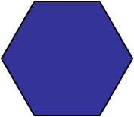
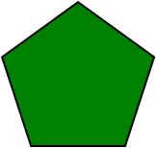
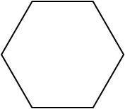
Sugar- Mapped out
Glucose
Glucose + Glucose = Maltose
Fructose
Glucose + Fructose = Sucrose
Galactose
Glucose + Galactose = Lactose
Notes:
Visual representation of the monosaccharides and disaccharides.

Slide 11
What are some names of sugar?
Chemical Name: SUCROSE or SACHAROSE
Other sugars:
  Dextrose/ Glucose (corn, grapes)
  Fructose (fruit)
  Lactose (dairy/ milk)
  Maltose (malt)

Slide 12
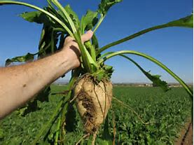
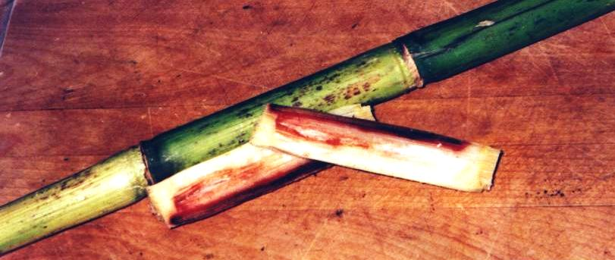
Sources of Sugar
Sugar Cane Sugar Beets

Slide 13
Sugar Cane
Tropical Grass: Florida, Hawaii, Louisiana, Texas
12-14% sucrose
Processes first at sugar mills, then at refineries

Slide 14
Sugar Beet
Temperate Climates: California, Colorado, Idaho, Michigan, Minnesota, Montana, Nebraska, North Dakota, Oregon, Wyoming, Washington
16-18% sucrose
4-7 months harvest season

Slide 15
Sugar Processing: Sugar Cane
Grind the cane to extract the juice
Boil the juice until the syrup thickens and crystallizes
Spinning the crystals in a centrifuge to produce raw sugar
Shipping the raw sugar to a refinery to:
Wash, filter, and remove any non sugar ingredients and color then,
Crystallized, dried and packaged.

Slide 16
Sugar Processing: Sugar Beet
Beets are washed, sliced and soaked in hot water to separate the sugar containing juice from the beet fiber
The sugar-laden juices is purified, filtered, concentrated and dried in a series of steps similar to sugar cane processing.

Slide 17
How it’s made:
Sugar beet: https://www.bing.com/videos/search?q=sugar&&view=detail&mid=B6809ACC02A897644BC2B6809ACC02A897644BC2&&FORM=VRDGAR
Sugar cane:
https://www.bing.com/videos/search?q=sugar+cane+processing&&view=detail&mid=BC2FD715863F756E0302BC2FD715863F756E0302&&FORM=VRDGAR

Slide 18
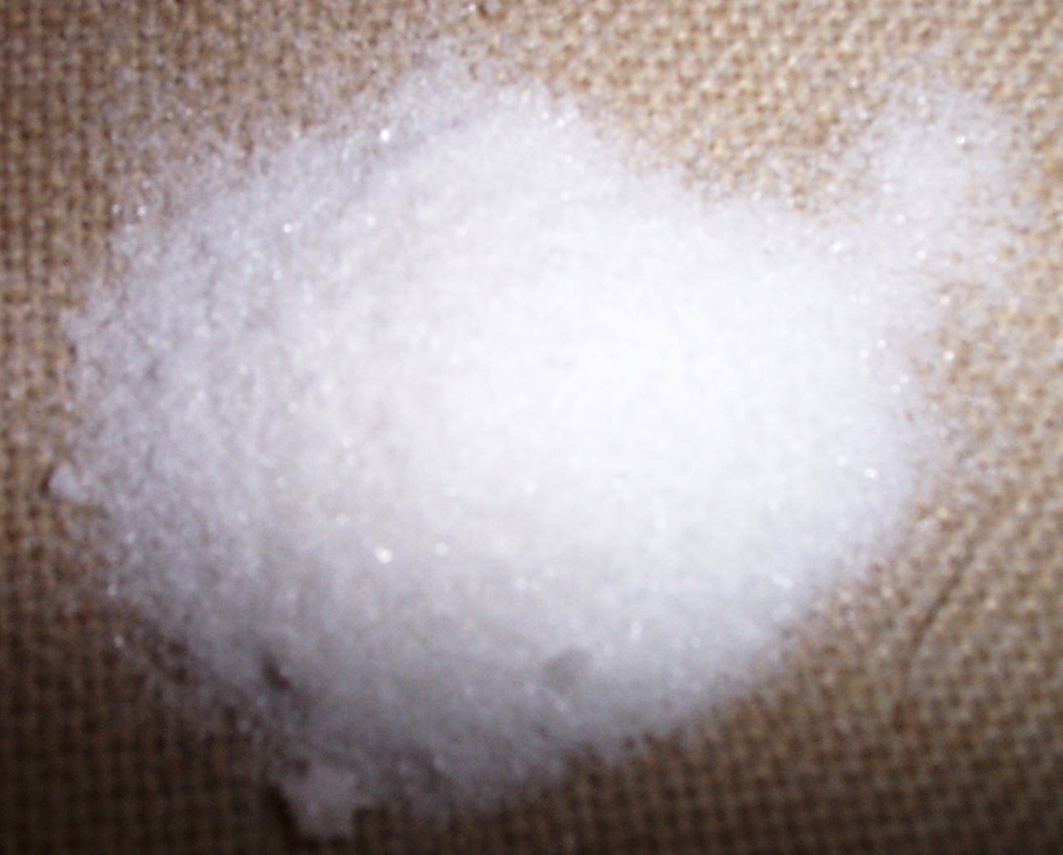
Granulated Sugar
Highly refined cane or beet sugar.
  Also called White Sugar.

Slide 19
Molasses
To harvest cane sugar, the plants are harvested, and shredded to remove juice. The juice is found in the pith of the stems.
Water is add to juices, and then boiled until crystalized.
This produces molasses.
This liquid is then centrifuged until crystals separate.
  Raw sugar contains approximately 1 % impurities.

Slide 20
Molasses
Molasses- Refined from the concentrated juice of sugar cane. Contains 24% water. Sweetness equivalent to sugar
  Made in three stages resulting in three grades
    “First”
    “Second”
    “Third” or “Blackstrap”
Black strap Molasses- Formed after the third time of crystallization. It is the most concentrate. It is the darkest and most bitter.

Slide 21
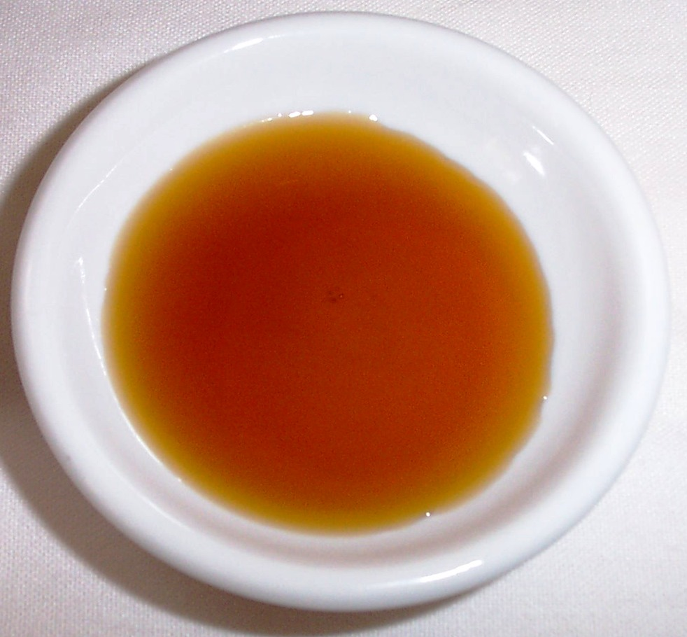
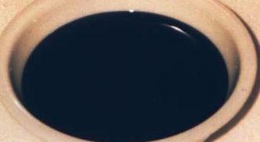
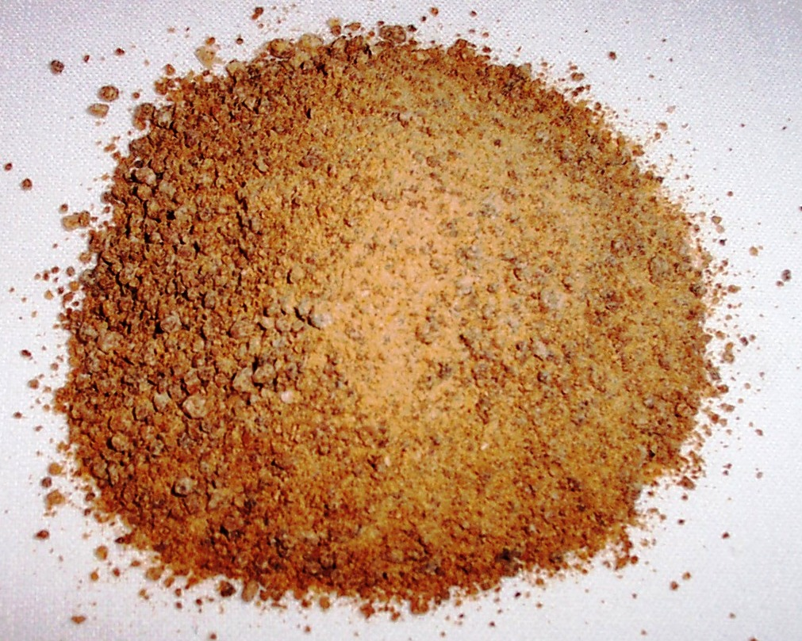
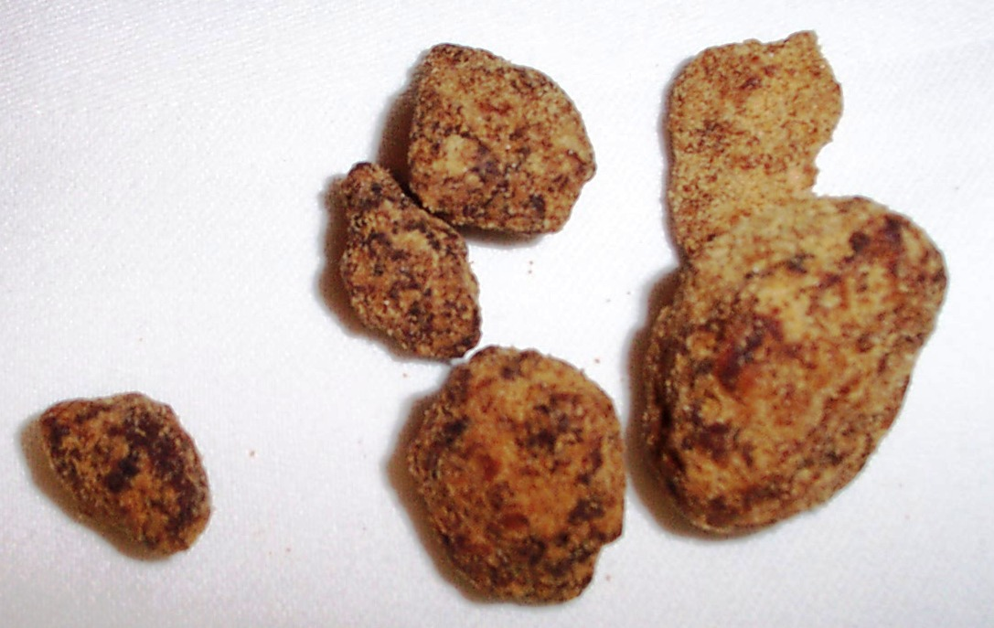
Pure Sugar Cane Juice
Molasses
Crystallized Sugar Cane Juice
Granulated Sugar Cane Juice

Slide 22
Brown Sugars
Refined sucrose with some of the molasses returned to the sugar.
  Light Brown Sugar- 3 ½ % molasses added.
  Dark Brown Sugar- 6 ½ % molasses added.
    Brown sugars have the same sweetness as white sugar, but must be packed when measuring because of the high moisture content.
      Granulated sugar is approximately .5% moisture
      Brown Sugar is approximately 2.1% moisture
    1 cup packed brown sugar= 1 cup granulated sugar + 1/4 cup unsulfured light molasses.
    1 cup dark brown sugar= 1 cup granulated sugar +1/2 cup unsulfured light molasses.
Muscovado sugar is a British sugar that is very dark brown and a particularly strong molasses flavor

Slide 23
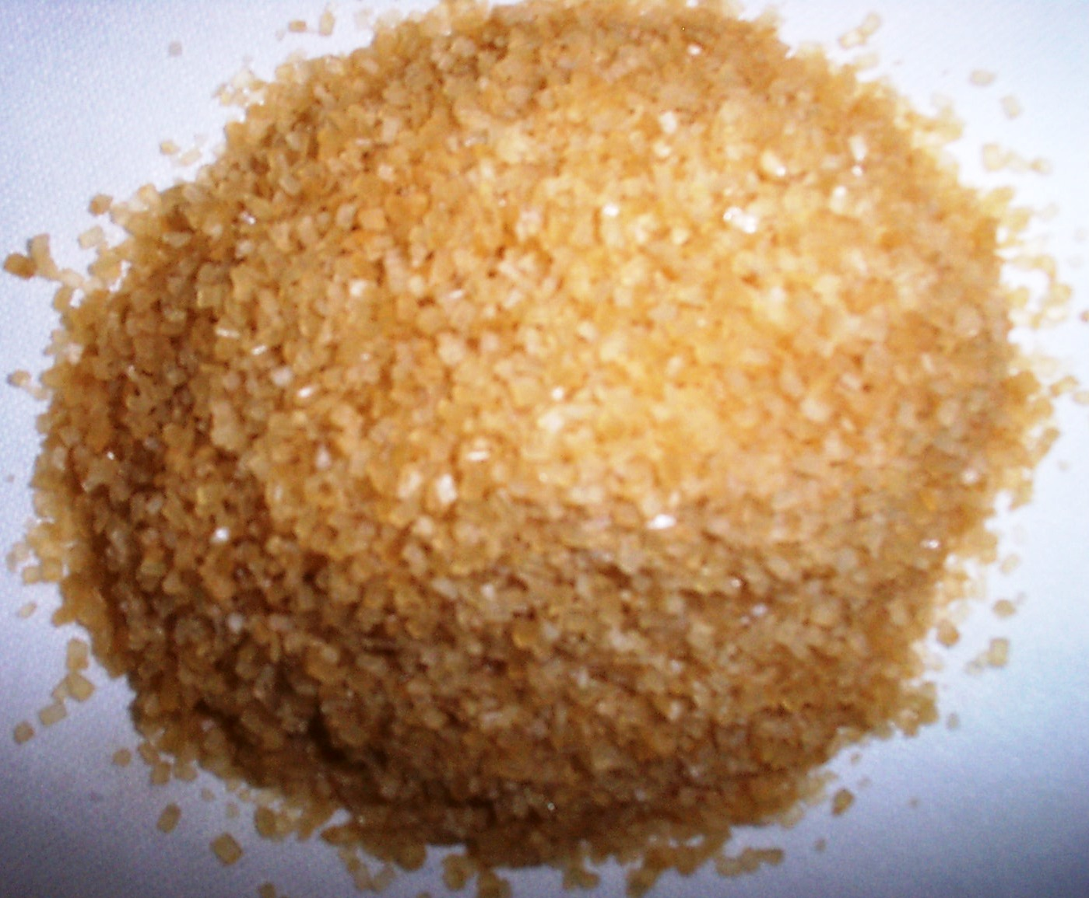
Turbinado
Raw sugar that has been steam cleaned. Coarse crystals are blond colored. Has a slight molasses taste.
  Turbinado Sugar is raw sugar that has been refined to light tan color by washing in a centrifuge to remove surface molasses
  Demerara Sugar is a light brown sugar with large golden crystals which are slightly sticky from the molasses

Slide 24
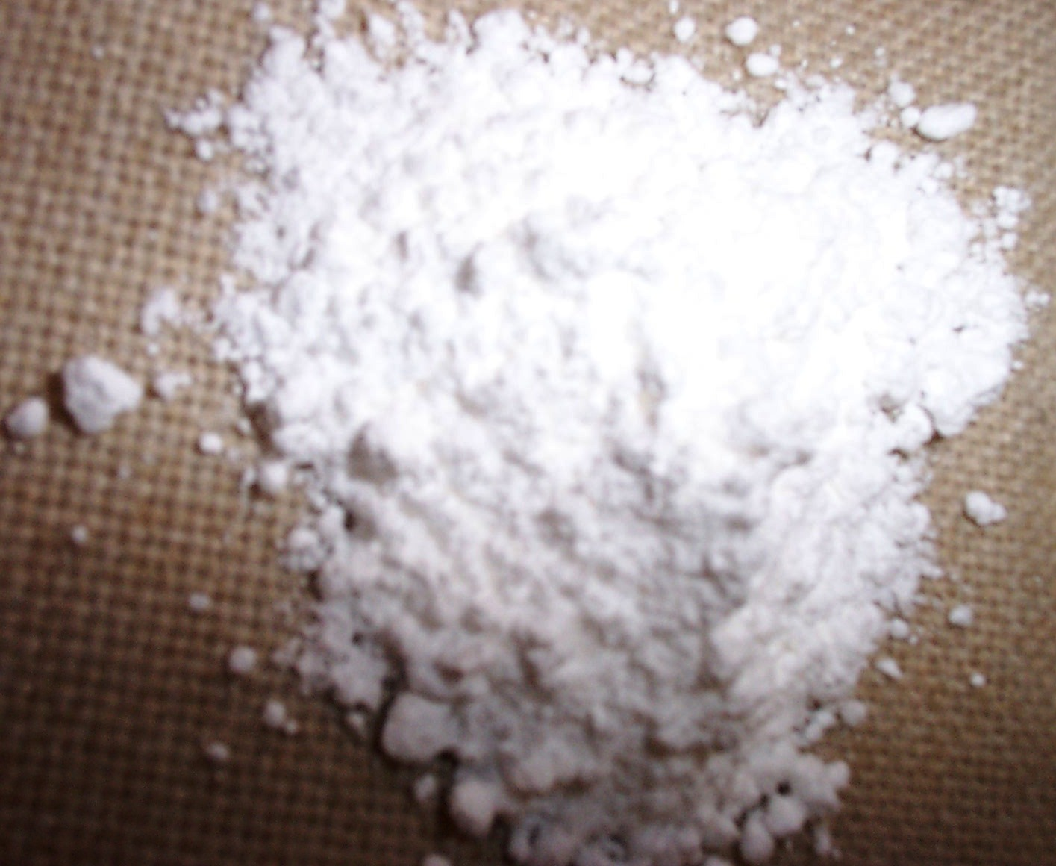
Powdered Sugar
Sugar ground until powdered in form.
Can only be made commercially. Has cornstarch added to prevent clumping.
Comes in four degrees of fineness:
  10XX, 10X, 6X, and 4X. (10XX is the finest, 4X is what is put on donuts)
AKA
  Confectioner’s Sugar
  Icing Sugar

Slide 25
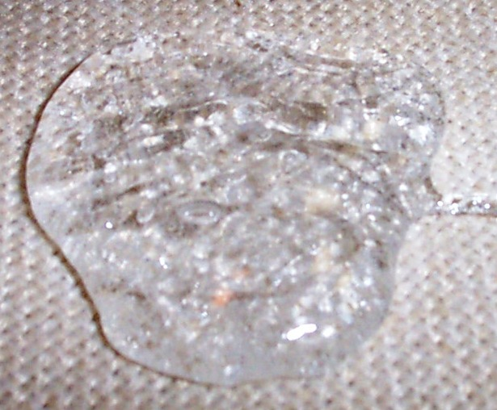
Glucose
Most naturally occurring sugar.
Effective in preventing crystallization and increasing pliability of molten sugars.
1/2 as sweet as granulated sugar. Browns at a lower temperature. Contains 15-19.7% water.
Used commonly in liquid form

Slide 26
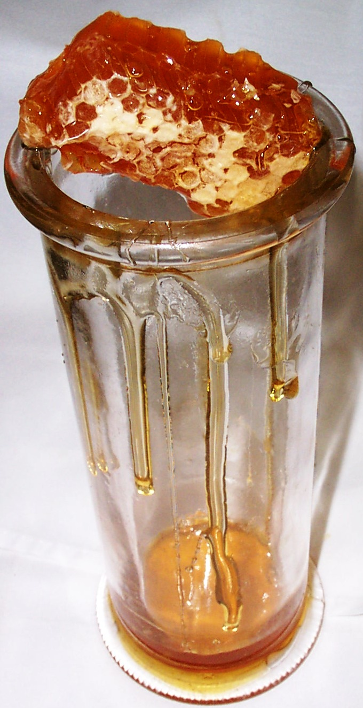
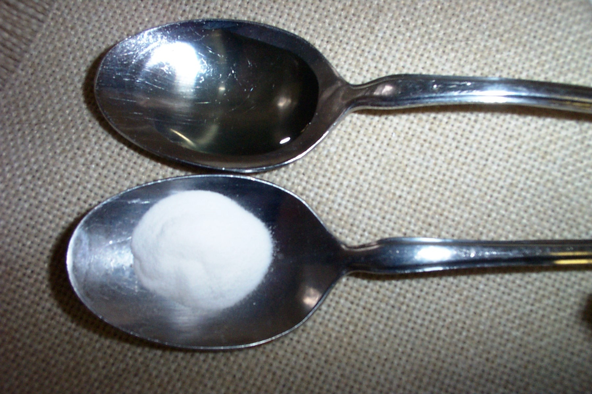
Other Sweet Things
Honey (fructose and dextrose)
Stevia (natural plant extract)
  200-300x’s sweeter than sugar when refined
  May be more tolerable for diabetics
  Does not caramelize

Slide 27
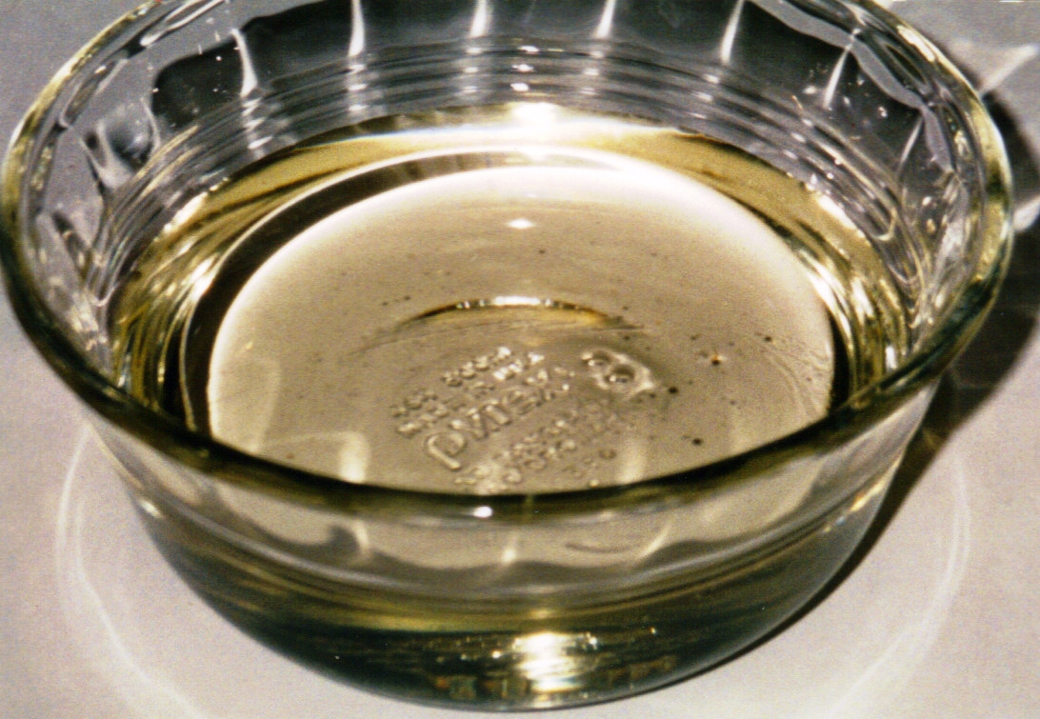
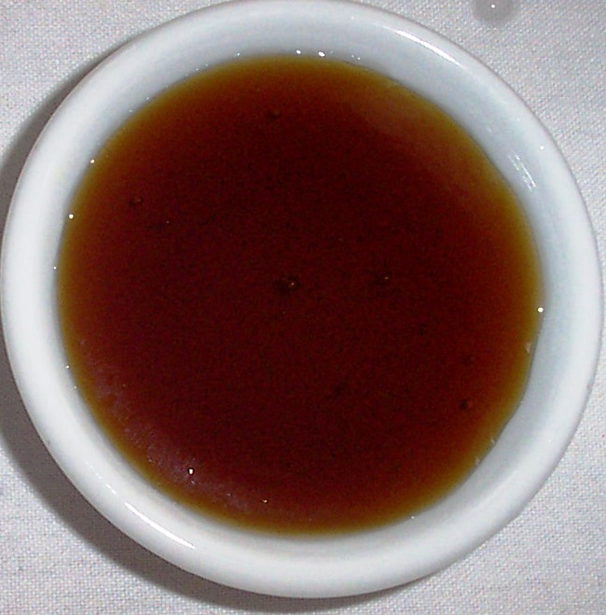
Other Sweet Things
Corn Syrup- A thick, sweet syrup created by processing cornstarch with acids or enzymes.
  1/2 the sweetening power of sucrose.
  both Light and Dark forms
  inhibits crystallization.
Agave (blue cactus leave extract)
    May be more tolerable for diabetics
Light Corn Syrup
Dark Corn Syrup

Slide 28
Other Sweet Things
Malt
Extracted from barley that has been ground then heated with water to form the concentrated liquid. Used primarily in yeast breads to provide food for yeast and to add flavor

Slide 29
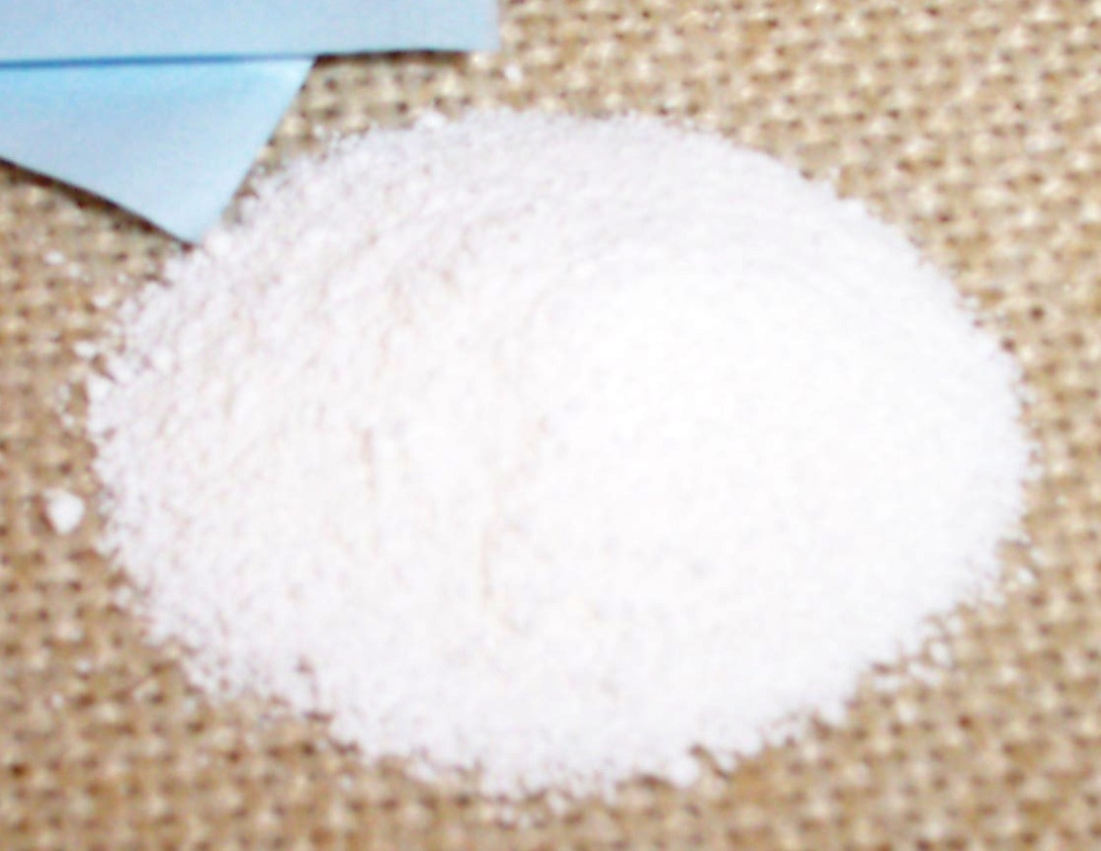
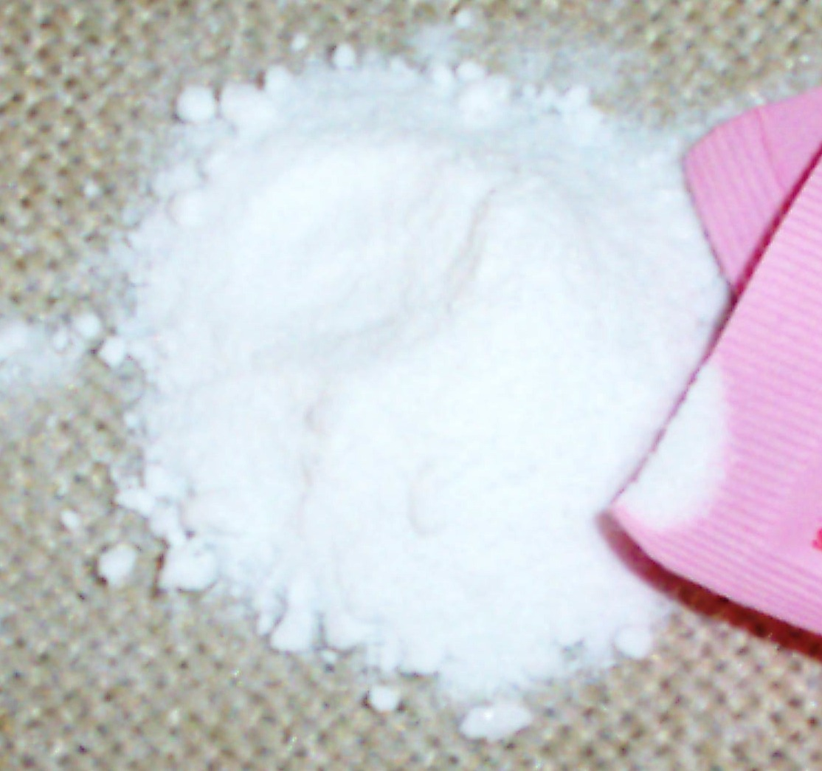
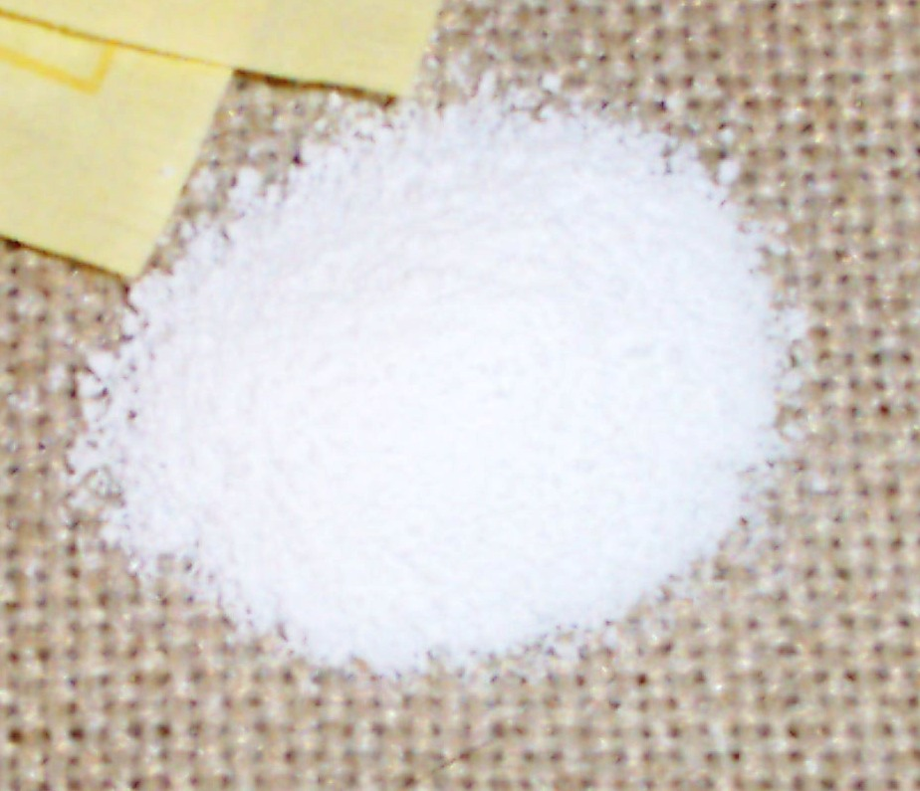
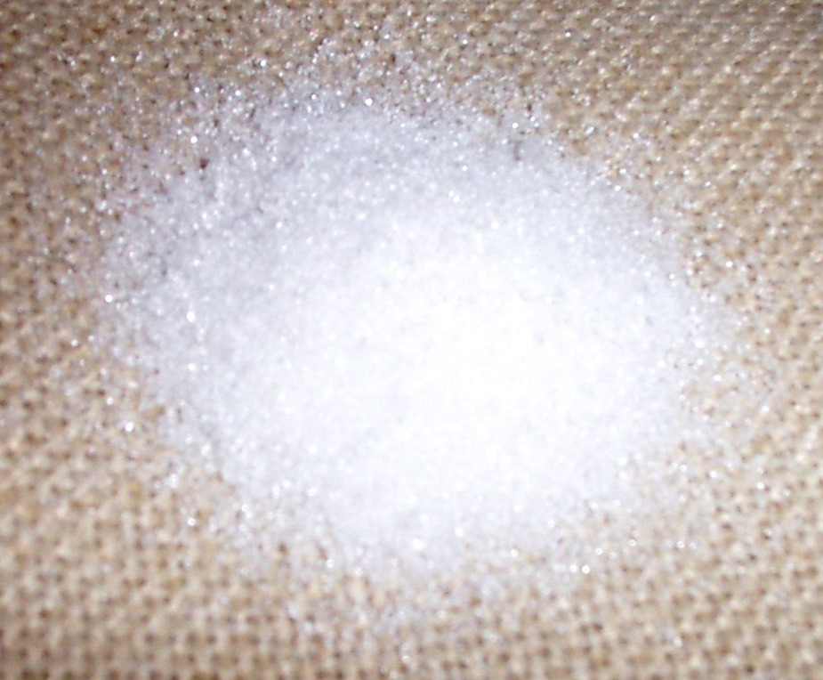
Artificial Sweeteners (glucides)
Aspartame- 200x’s sweeter
Saccharin
Sucralose- 600x’s sweeter
Xylitol-
  dental benefits
  Could be diabetic friendly

Slide 30
Forms of Sugar
Isomalt- An odorless, white, crystalline. It has a low hydroscopity, doesn’t crystallize, or caramelize. It is good for piped, pulled, or cast sugar pieces.
Maple Sugar- Crystallized by the evaporation of maple sap from the sugar maple tree. It is finely granulated. Can be substituted into recipes by equal weight.
Maple Syrup- Concentrated sap of the sugar maple tree. Contains approximately 23% water.

Slide 31
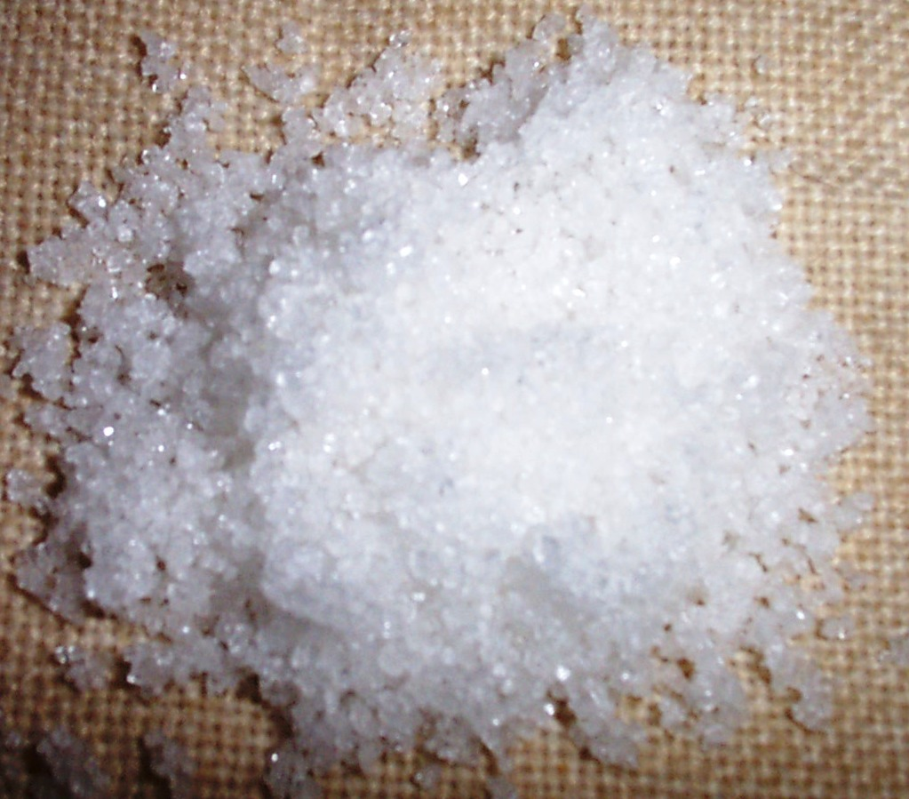
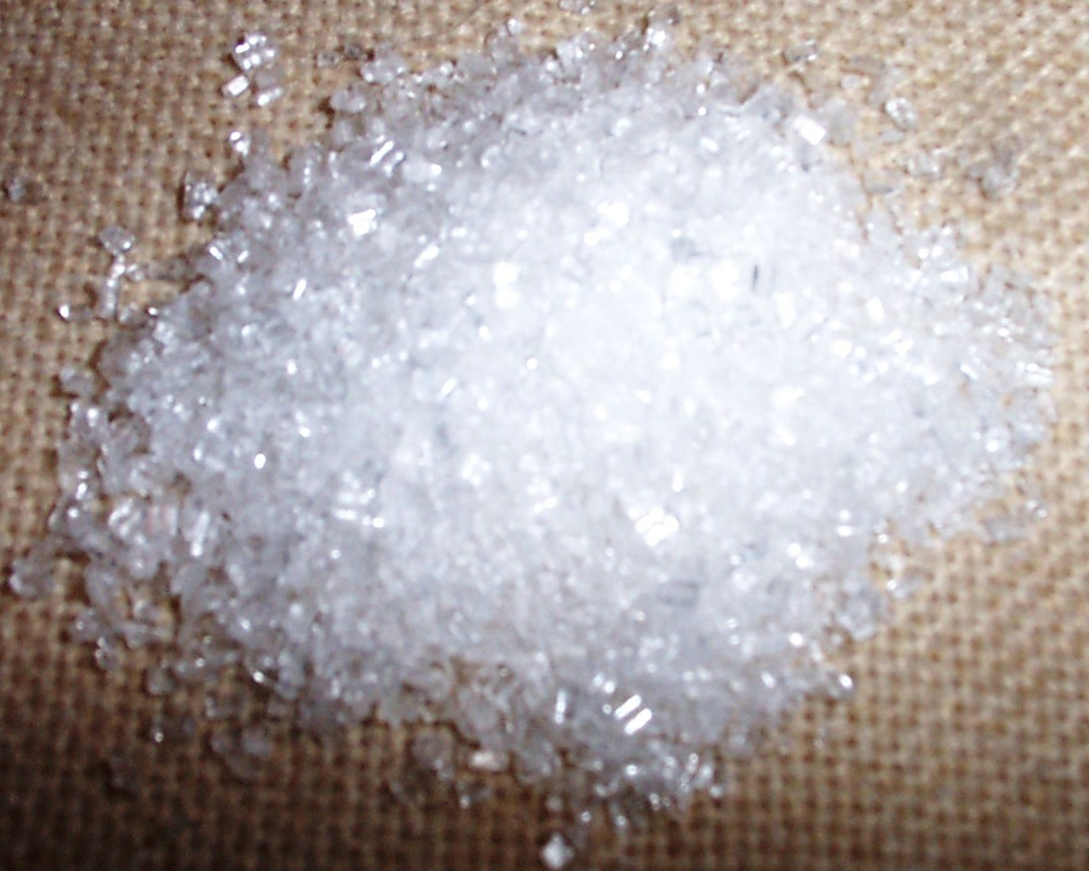
Sanding Sugar- A large crystal sugar that is resistant to color change due to absence of impurities. Ideal for confections. Also called Medium Coarse Sugar, Coarse Pearl Sugar, and Strong Sugar.

Slide 32
Let’s identify some sugars!

